Slide 1
Climate Change Vulnerability Assessment and Adaptation Plan
Stevie Freeman-Montes
City of Sarasota Sustainability Manager

Slide 2
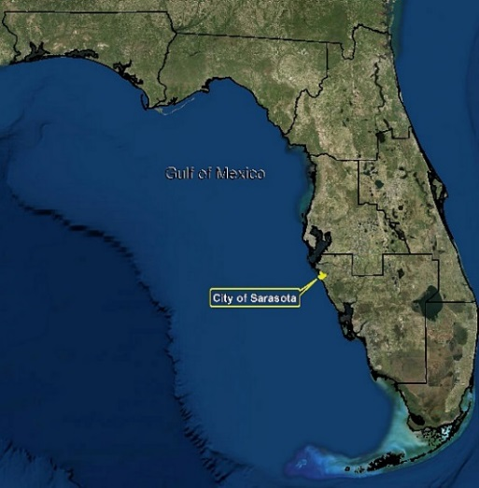
City of Sarasota
City of Sarasota:
Sarasota Bay and barrier islands (Lido Key; Siesta Key)
~ 24 sq. mi. including approximately 10 sq. mi. water
~ 40 mi. of coastline surround the City
~ 32 mi. man-made; eight miles natural land
City mainland (approx. 16ft above sea level)
Barrier islands (avg. ~ 3ft above sea level)
Temperature range
72°F (winter) to 90°F (summer)
Average of 53.6 inches of rain
Majority during summer months

Slide 3
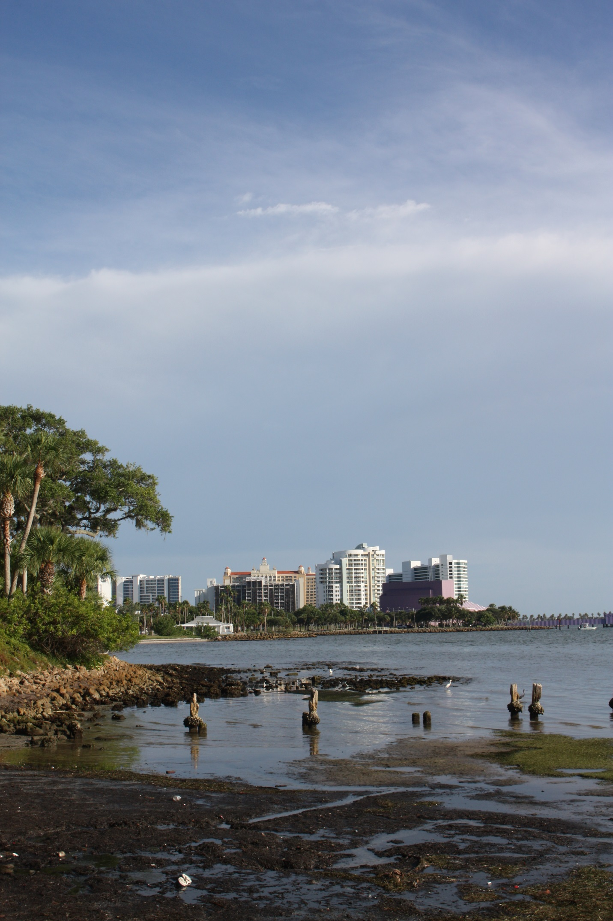
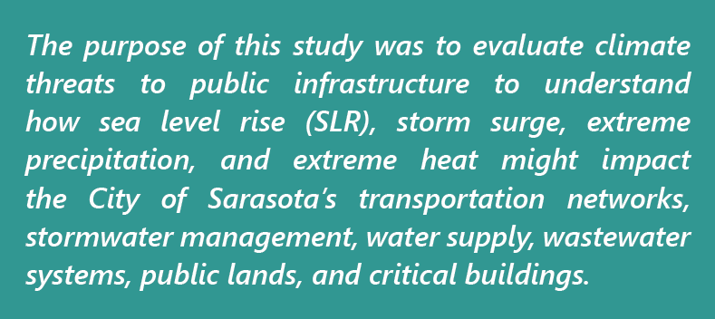
Purpose of the Climate Adaptation Plan
Ensure public services into the future
Remain competitive, resilient, and well-planned
Enhance the conversation about climate science
Identify opportunities for funding
Improve planning and policy
Photo| Sherri Swanson
Notes:
Normalize the climate science conversation, be strategic about funding, integrate climate science into planning and policy
There was a focus on critical infrastructure

Slide 4
Scope of Study
Government
Infrastructure
Neighborhoods
Businesses
Resiliency

Slide 5
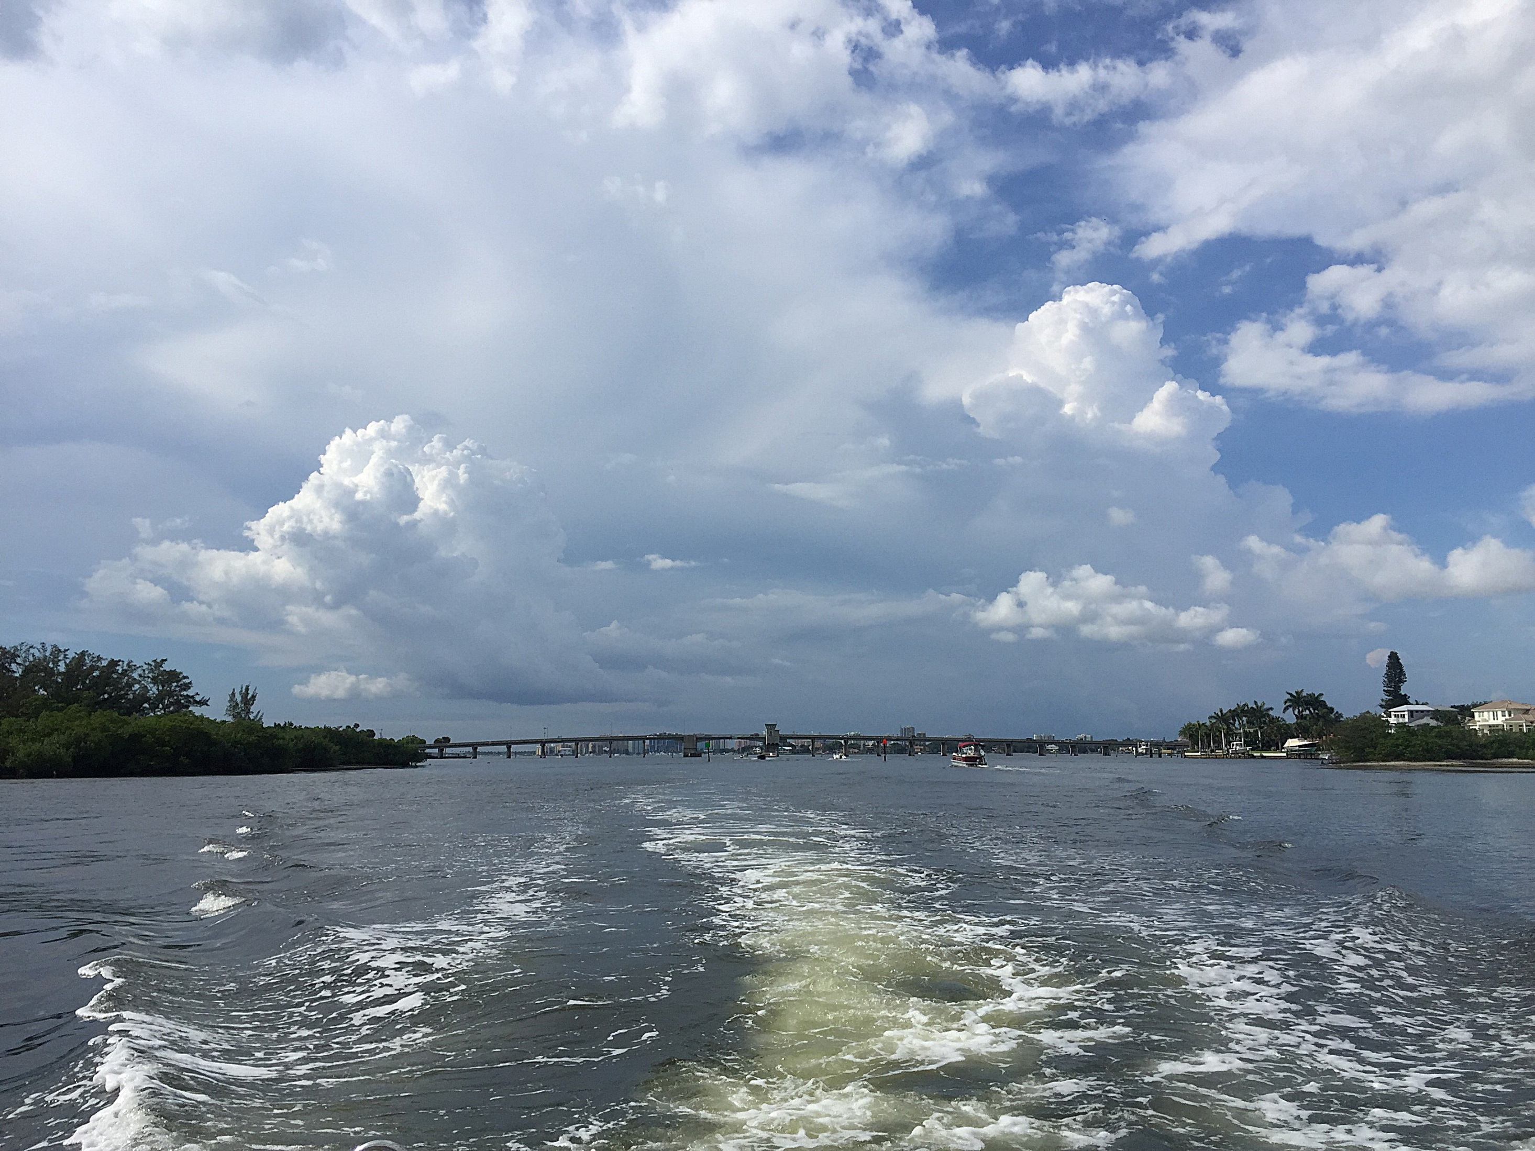
Six Step Process
Step
1
Step
5
Step
6
Step
2
Step
3
Step
4
Reaserch and Analyze Climate Trends
Infrastructure Inventory
Vulnerability Assessment
Prioritize Vulnerabilities
Identify Adaptation Strategies
Adaptation Plan
Photo| Sherri Swanson

Slide 6
Project Timeline

Slide 7
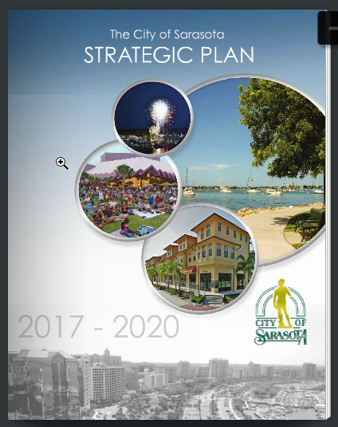
Current Climate Policies
Commission-Adopted Strategic Plan 2017-2020
Utilize scientific climate data to better predict future impacts to Sarasota, and to inform long-range planning, zoning, and administrative decisions
Establish a City of Sarasota Climate Adaptation Plan
Comprehensive Plan (2017)
Goal: It shall be the goal of the City of Sarasota to adopt, implement and encourage strategies which increase community resiliency and protect human life, natural systems, cultural resources, and public and private property from the impacts of climate change.

Slide 8
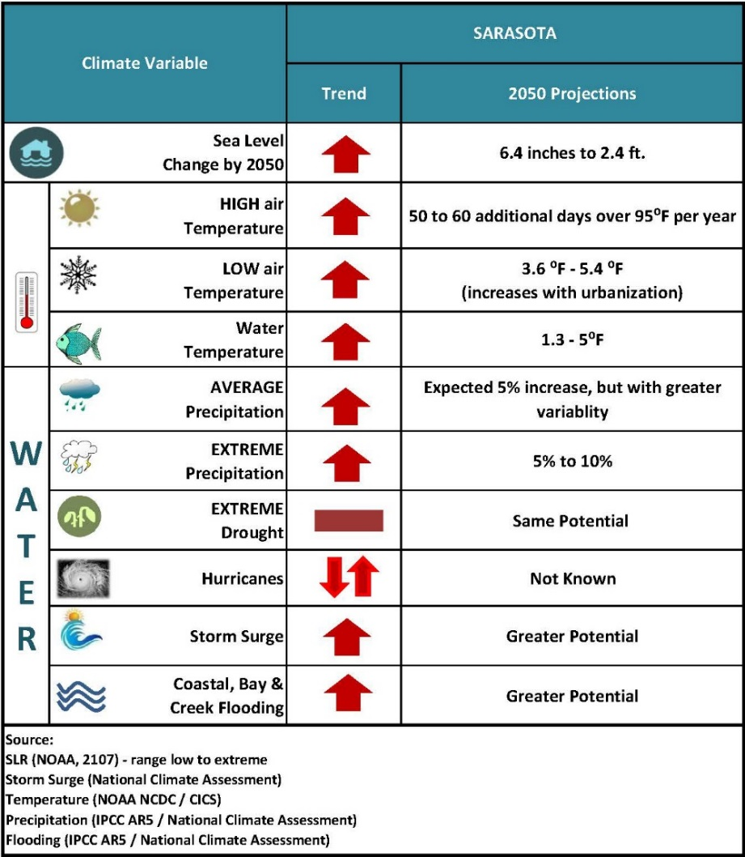
Step 1 Identify Local Climate Projections
Sea Level Rise
focus 2050
Storm Surge
plus SLR 2050
Extreme Rainfall
Extreme Heat

Slide 9
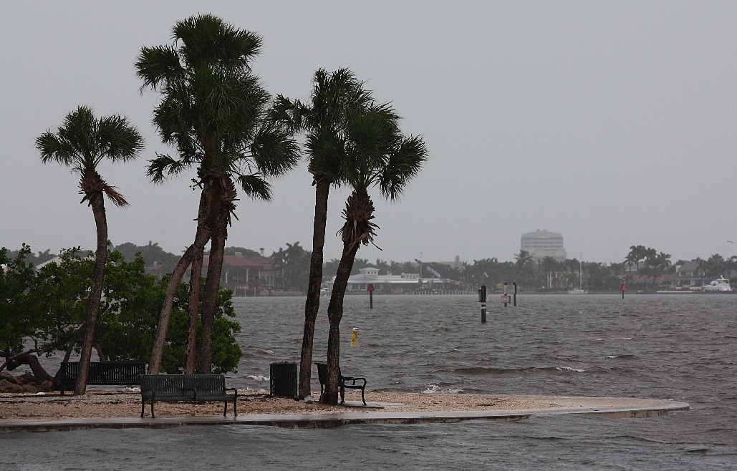
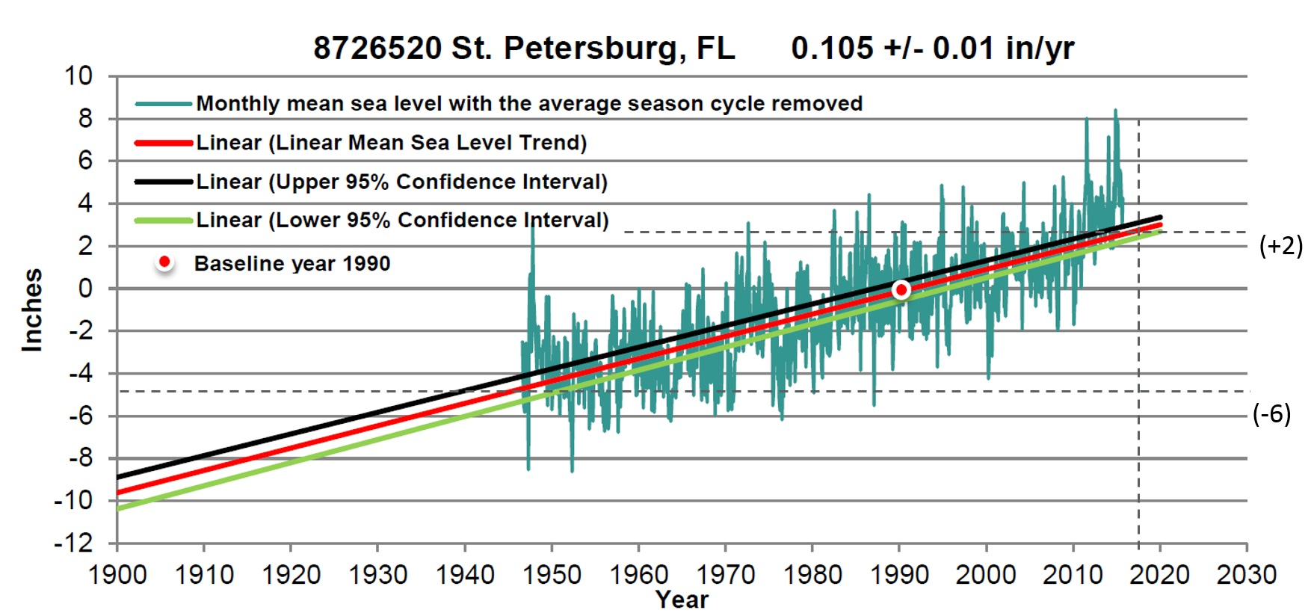
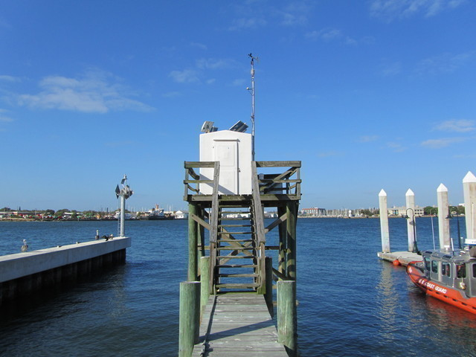
Historical Sea Level Rise
7.3 inches of local SLR since 1947 (2.71 mm / year).
Photo| Sherri Swanson
Bayfront Park post Hurricane Hermine
NOAA tidal gauge: St. Petersburg
Source: National Oceanic and Atmospheric Association – St. Petersburg Tide Gauge

Slide 10
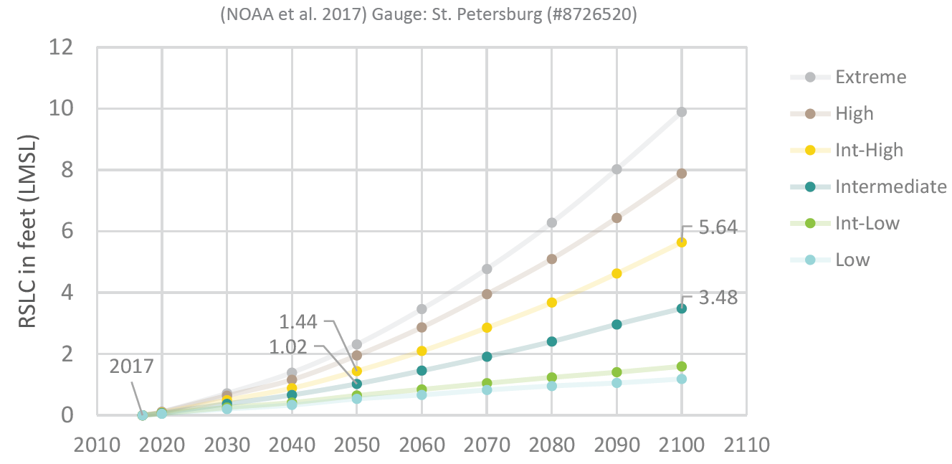
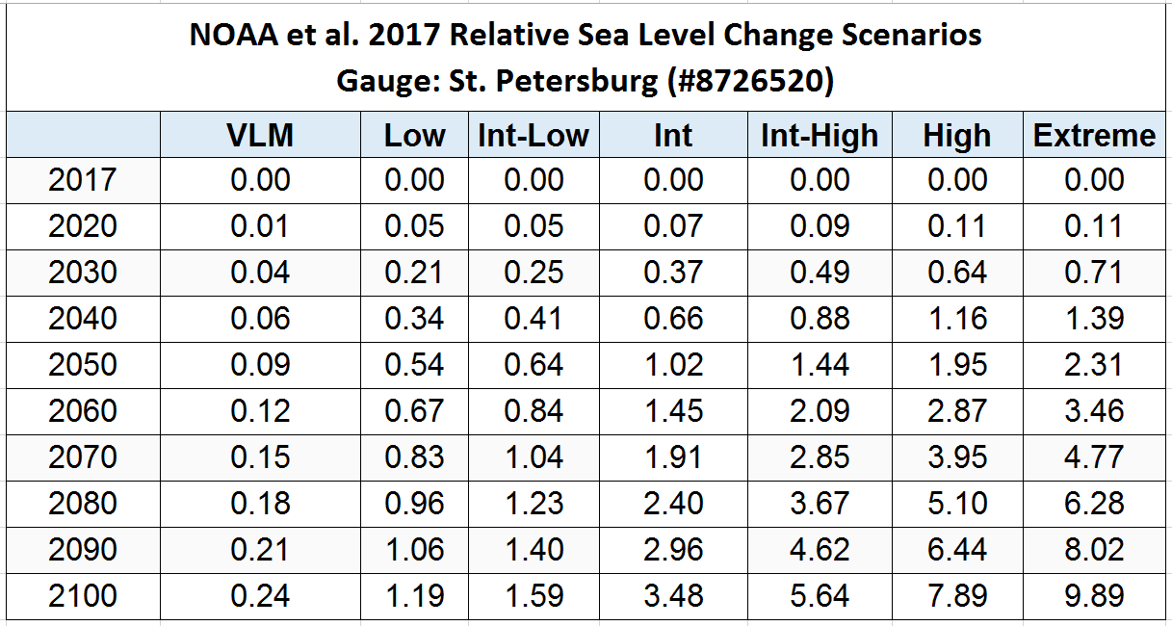
Sea Level Rise Projections
Our region is projected to experience
12 to 18 inches of SLR by 2050
(Intermediate to Intermediate high
NOAA 2017 scenarios)

Slide 11
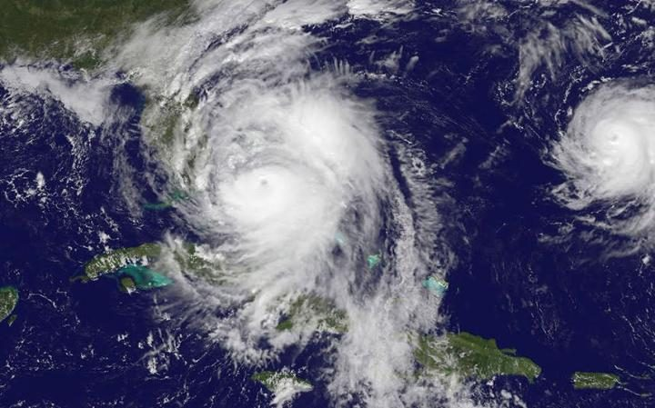
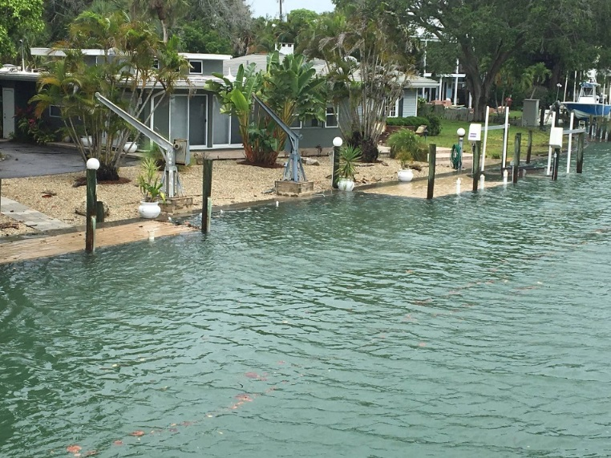
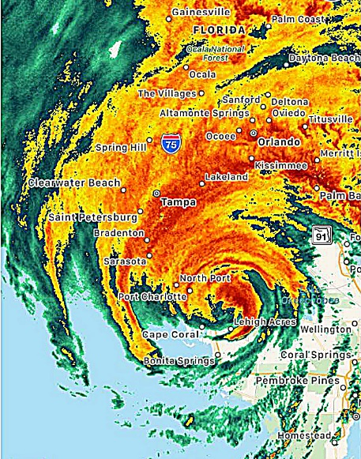
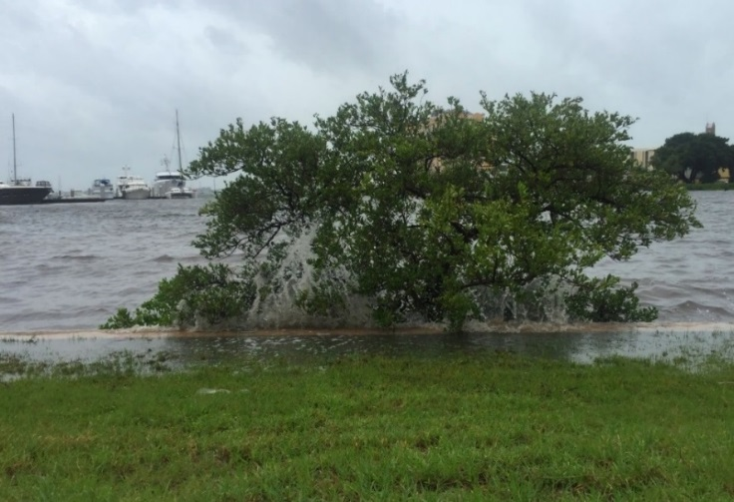
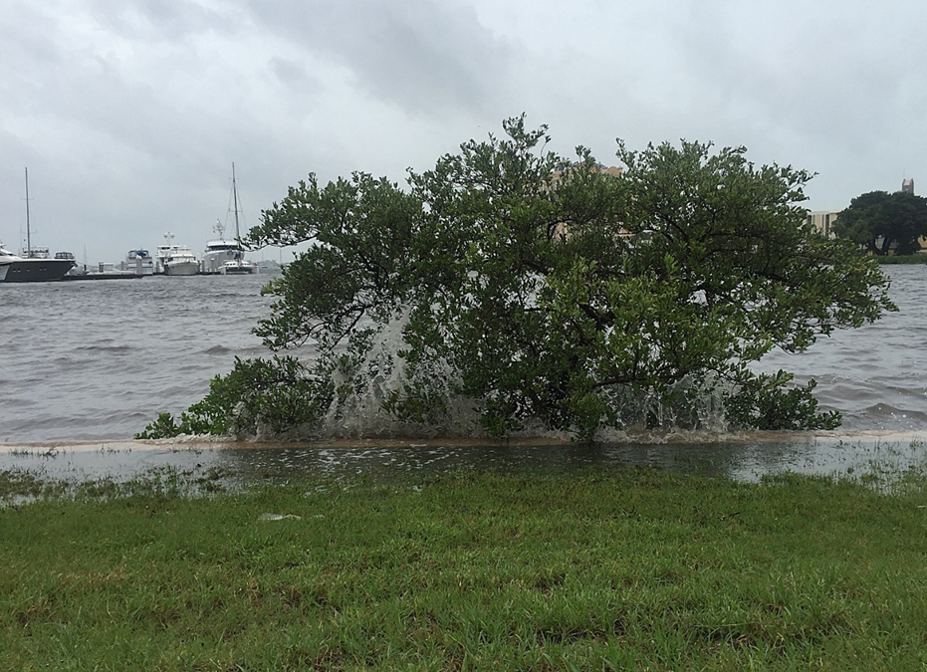
Storm Surge
Higher storm surges in 2050
Category 1 in 2050 will resemble today’s Category 2
Hurricanes & Tropical Storms
Hurricane Mathew
(Oct. 2016)
Tropical Storm Colin (June 2016)
Tropical Storm Hermine (Sept. 2016)
Photo| Sherri Swanson
Hurricane Irma
(Sept. 2017)
Notes:
Will hurricane’s increase and/or be stronger? Mixed science on this – there is science predicting stronger storms that feed on warmer waters.

Slide 12
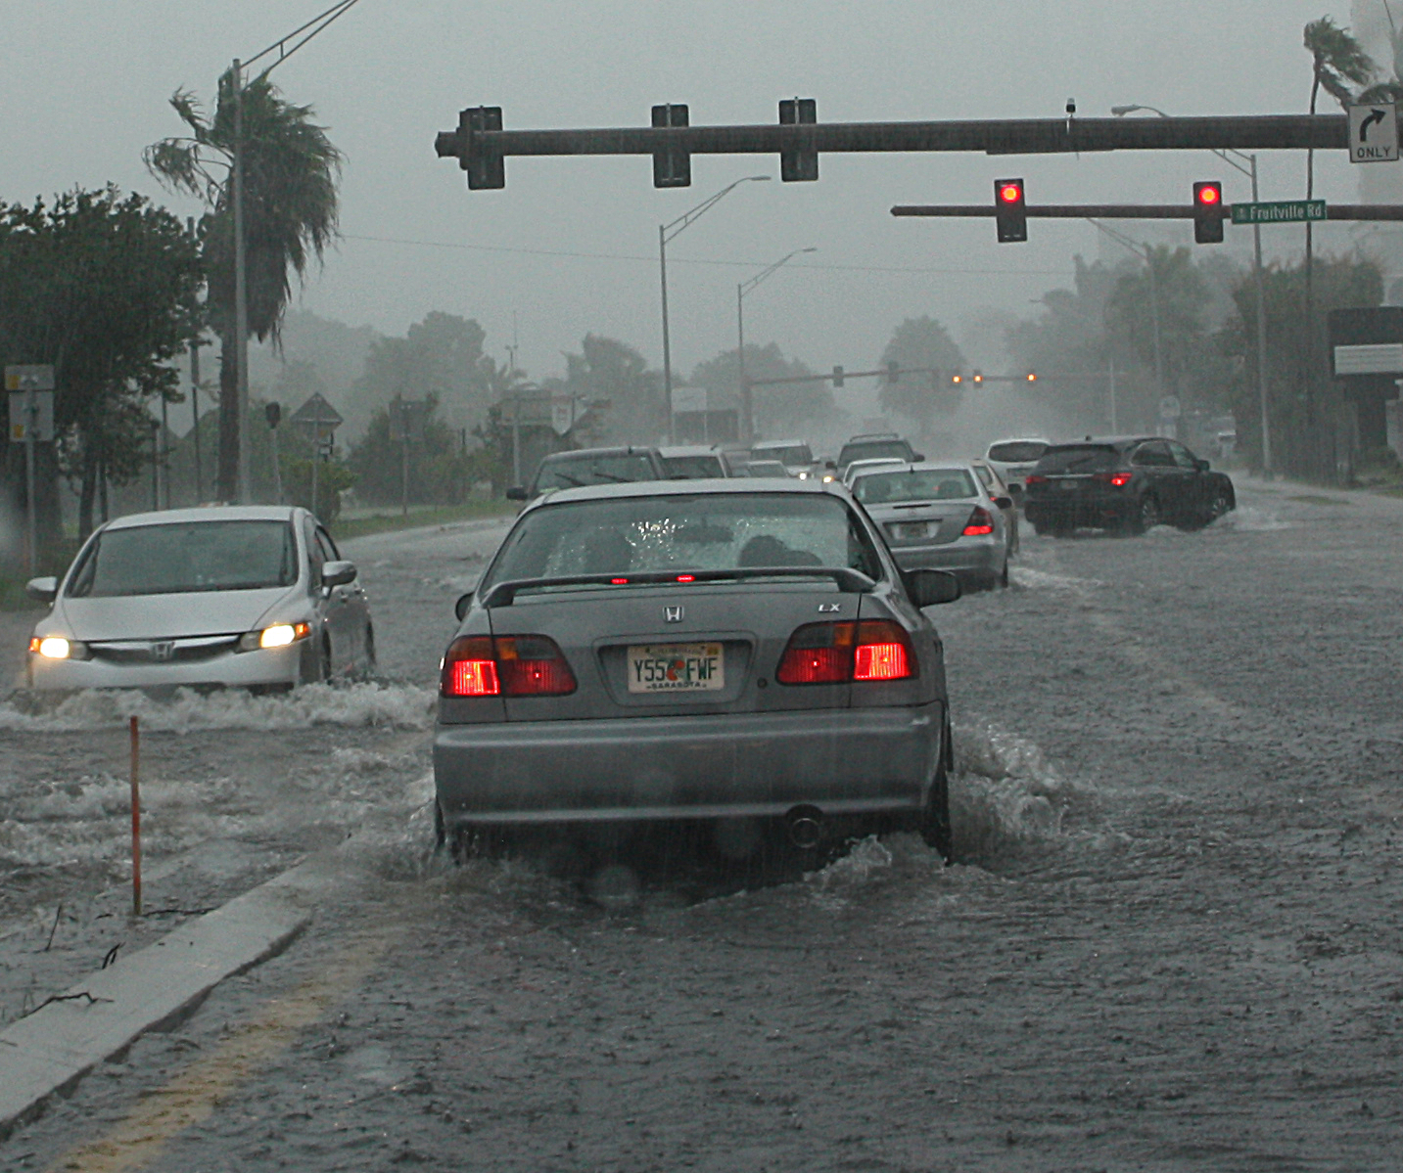
Extreme Precipitation
Increasing across Southeastern US
(NOAA National Center for Environmental Information)
5-10% increase by 2050
National Climate Assessment’s SE United States vs. local gauges
Seasonal and interannual variability
Photo| Sherri Swanson
Notes:
This picture is from a hard rain event – not a hurricane or named storm.

Slide 13
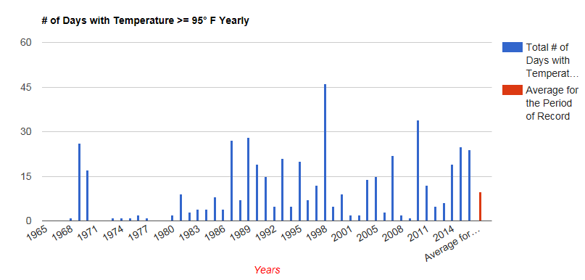
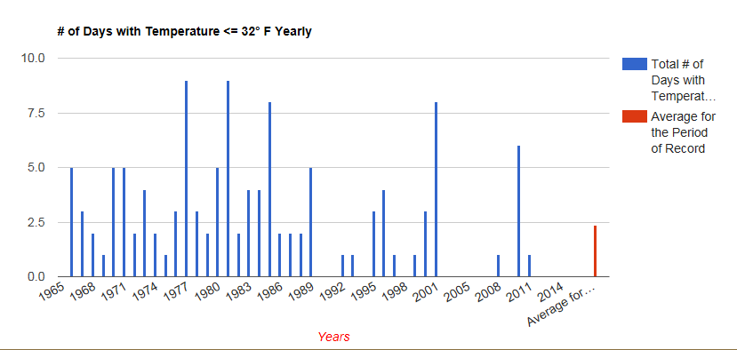
Extreme Heat
Average mean temperature has ↑ 2.2º F since 1965
(Source: Florida Climate Center, Data station 5mi ESE from Bradenton)
Air temperature ↑ 3.6ºF – 5.4ºF by 2050
50 to 60 days over 95º F / year
Sarasota Bay ↑ 1.3º – 5ºF

Slide 14
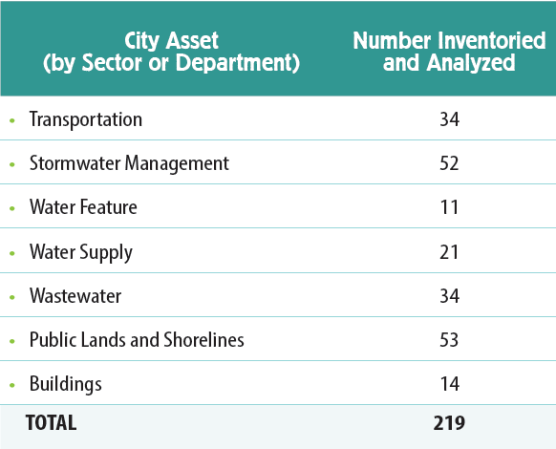
Step 2 - Infrastructure Inventory and Mapping
Photo| Sherri Swanson

Slide 15
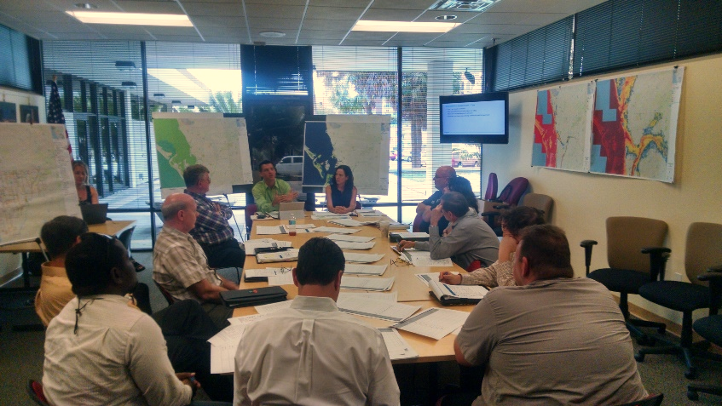
Step 3 - Vulnerability Assessment
Focus
Critical assets
Evacuation routes
High risk assets
Calculated Risk
Sensitivity X Adaptive Capacity
Likelihood X Consequence
Photo| Stevie Freeman-Montes

Slide 16
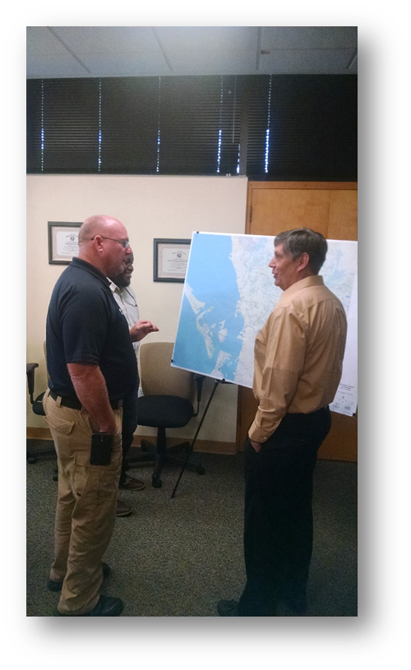
Vulnerability Scoring
Vulnerability = Sensitivity Score X Adaptive Capacity Score
Photo| Stevie Freeman-Montes
Notes:
Asked – is this asset currently experiencing impacts? Now look at the maps – is this asset projected to experience impacts in 2050? Tell us how susceptible it is to experience climate impact by 2050?
Adaptive capacity is asking folks to rank how well the infrastructure can adjust on its own with a 1-5.

Slide 17
Risk Assessment
Risk = Likelihood Score X Consequences Score

Slide 18
Step 4 - Prioritize Vulnerabilities
Priority Infrastructure
Risk
Vulnerability

Slide 19
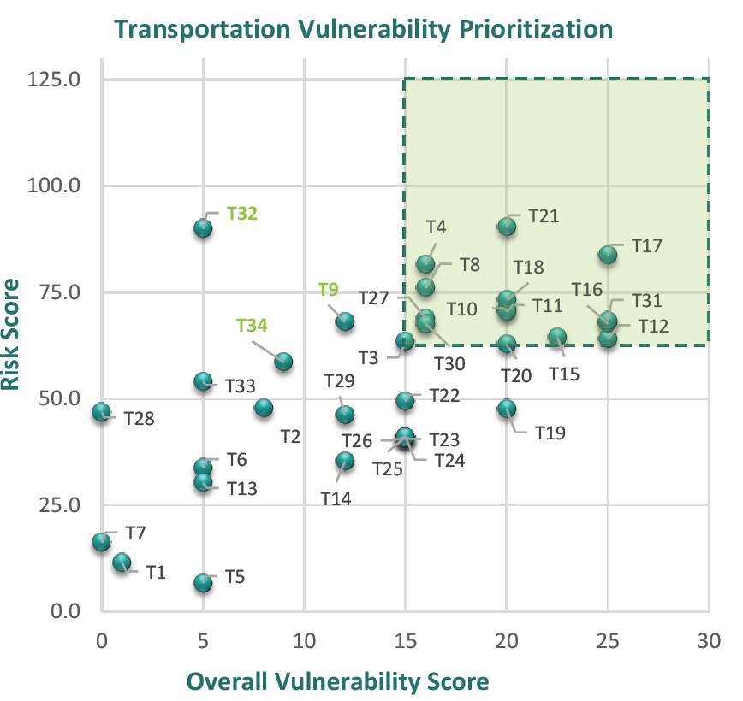
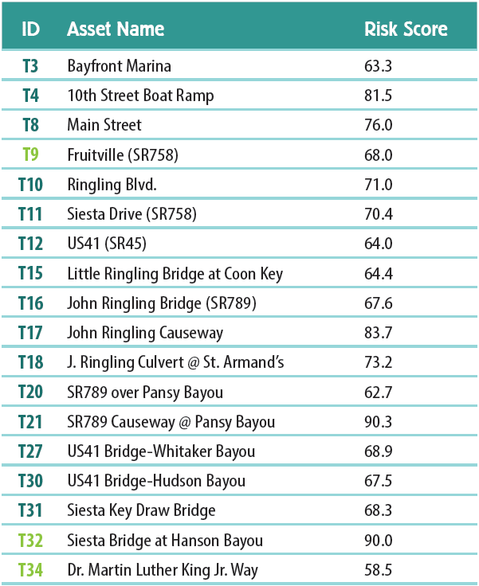
Transportation
Thirty-four (34) transportation assets were evaluated; fifteen (15) were deemed most vulnerable

Slide 20
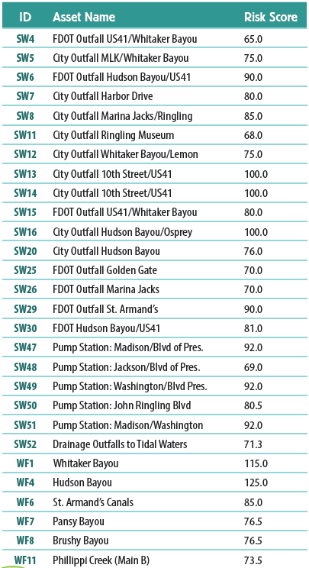
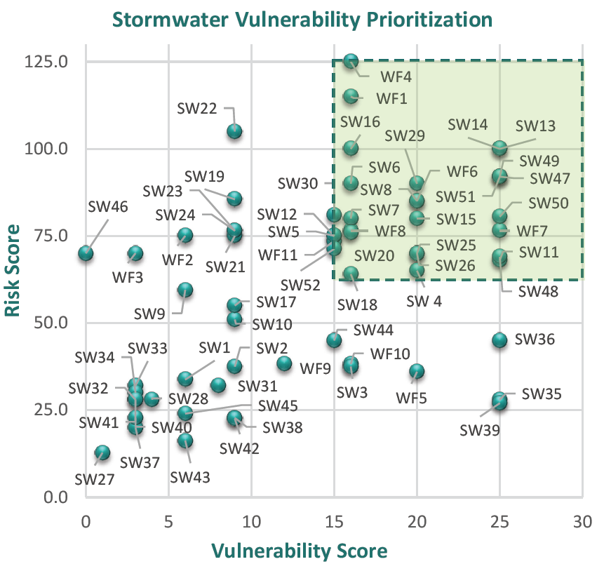
Stormwater
Fifty-two (52) stormwater assets were evaluated; twenty-nine (29) were deemed most vulnerable

Slide 21
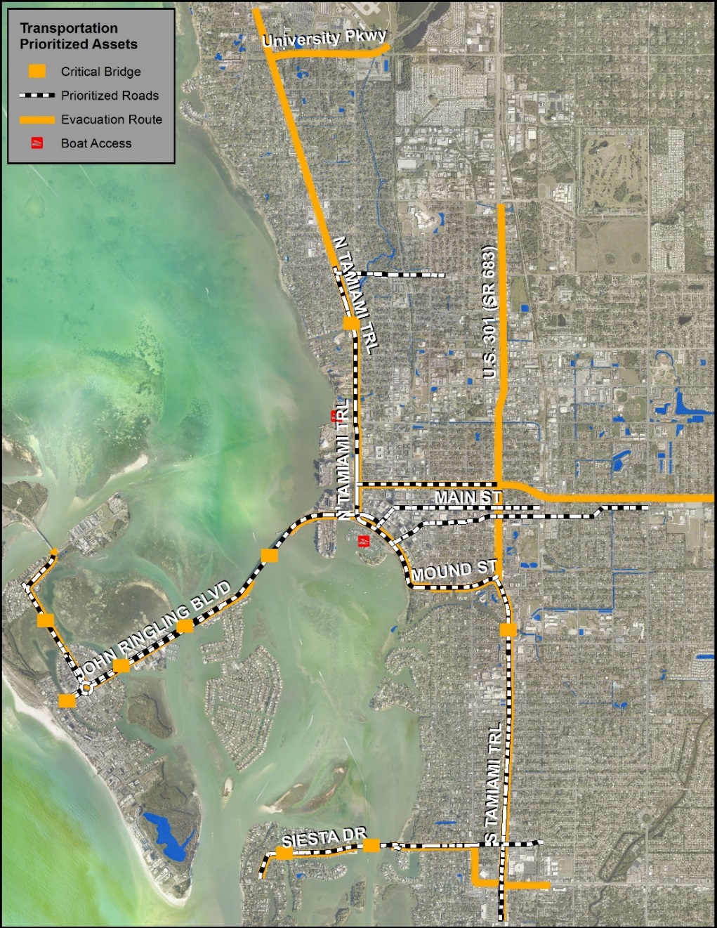
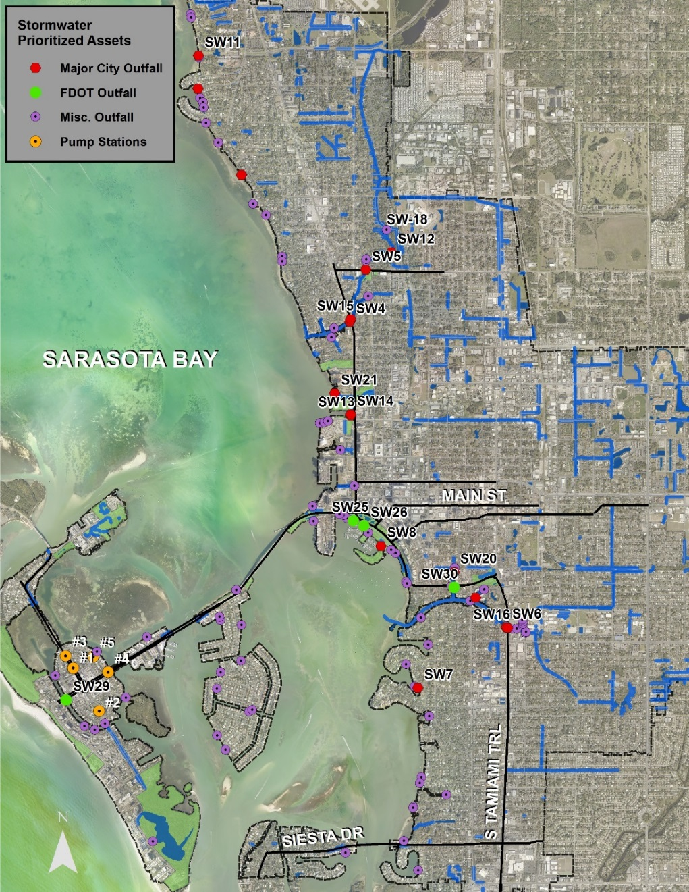
Notes:
Skip if needed

Slide 22
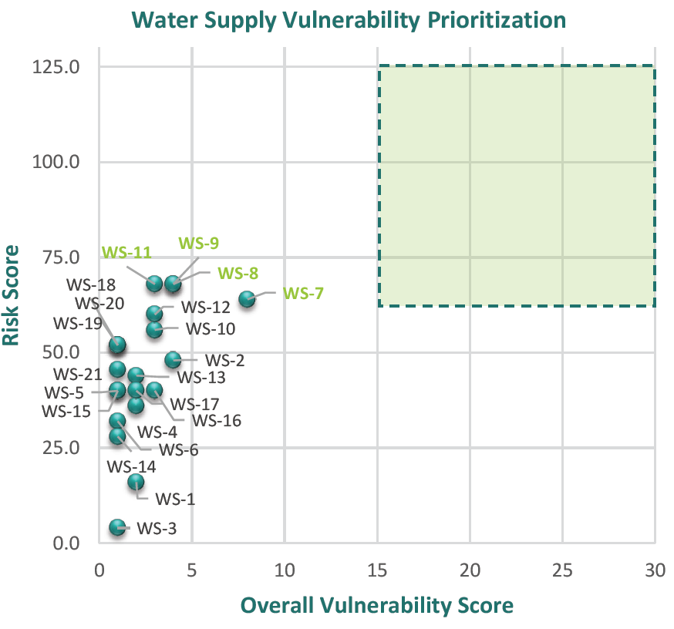
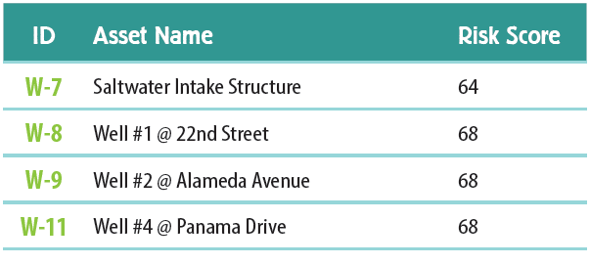
Water Supply
Twenty-one (21) water supply assets were evaluated; four (4) were deemed most vulnerable

Slide 23
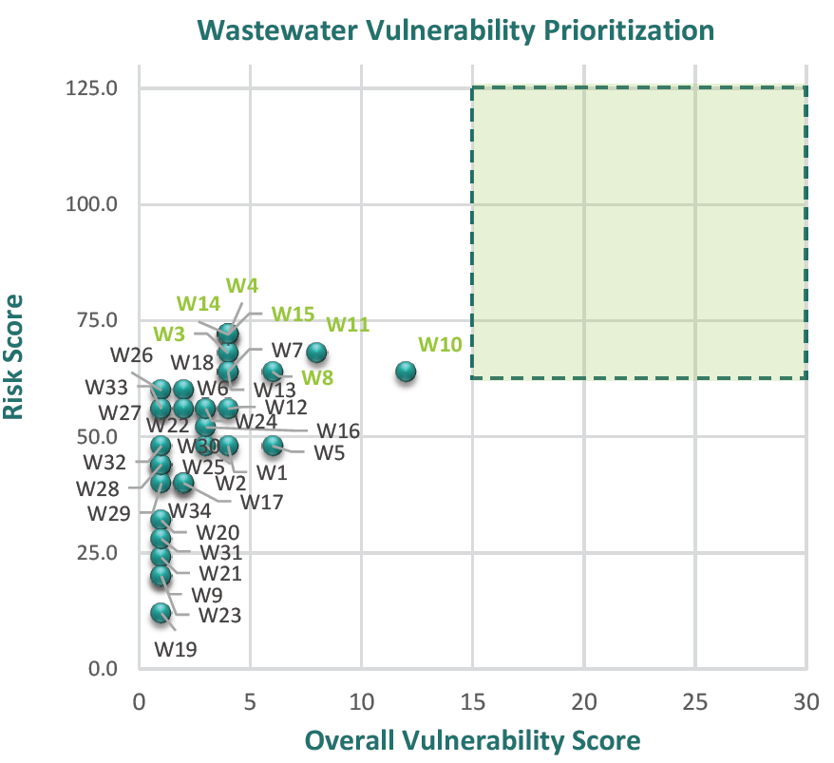
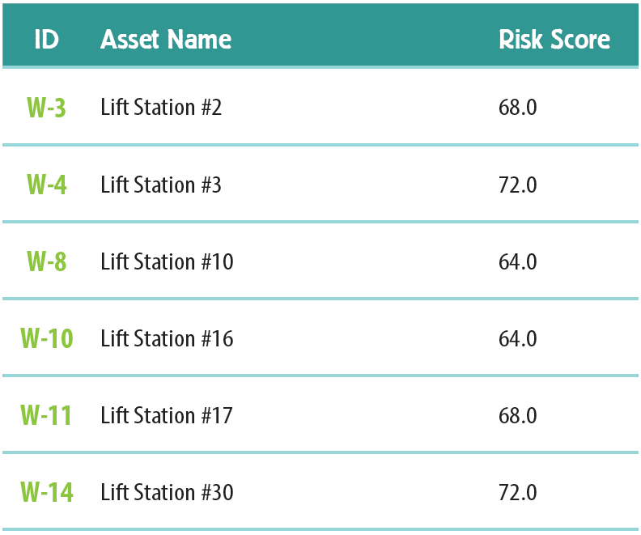
Wastewater
Thirty-four (34) wastewater assets were evaluated; seven (7) were deemed most vulnerable

Slide 24
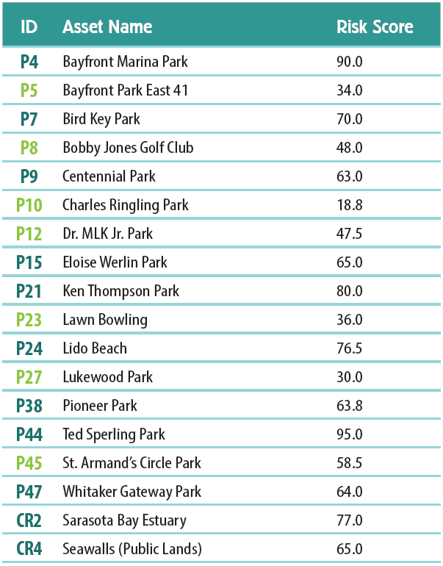
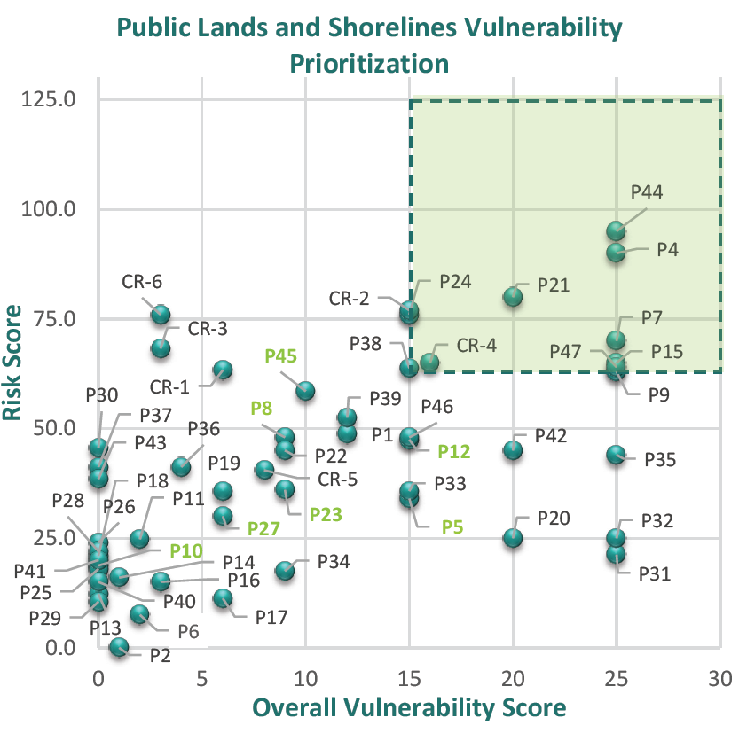
Public Lands and Shorelines
Forty-seven (47) public lands and six (6) shorelines were evaluated; nine (9) public lands and two (2) shorelines were deemed most vulnerable

Slide 25
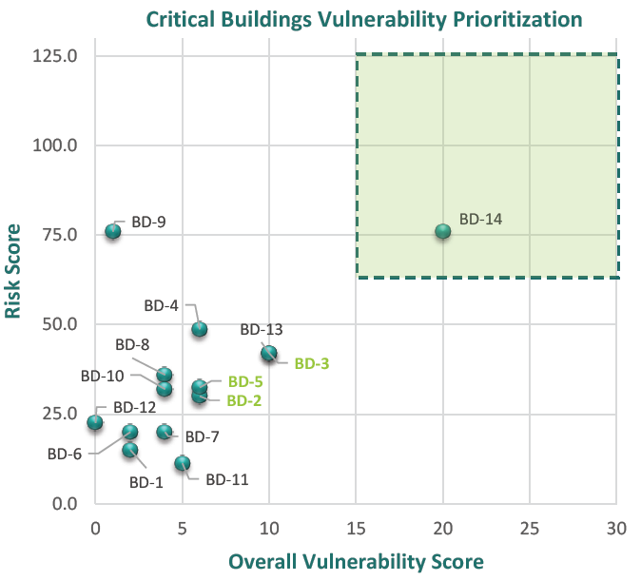
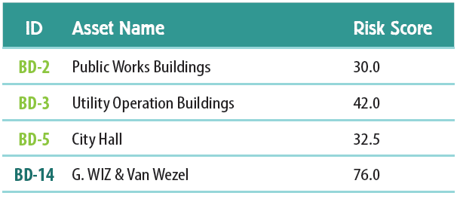
Critical Buildings
Fourteen (14) critical buildings were evaluated; four (4) were deemed most vulnerable

Slide 26
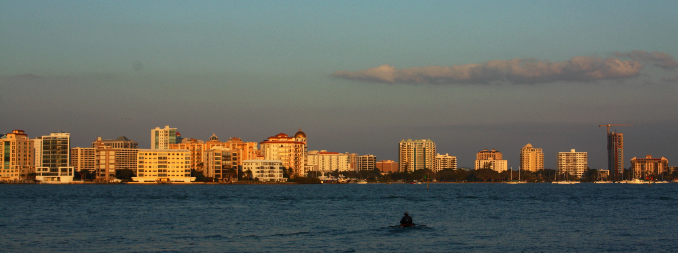
Vulnerabilities
Prioritized eighty (80) infrastructure assets (out of 219 evaluated)
Notes:
Twenty four (24) additional infrastructure assets that were not initially rated as high risk and vulnerability were prioritized due to site-specific conditions and local knowledge

Slide 27
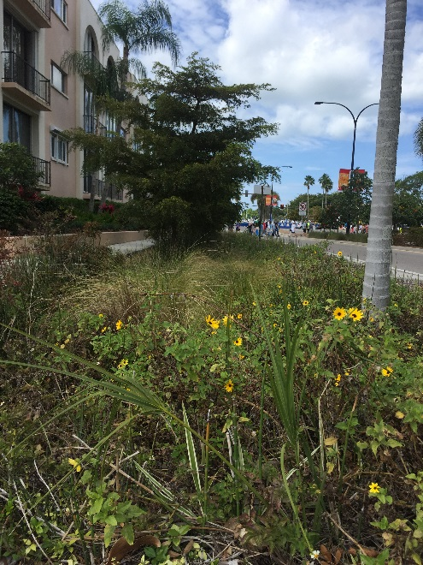
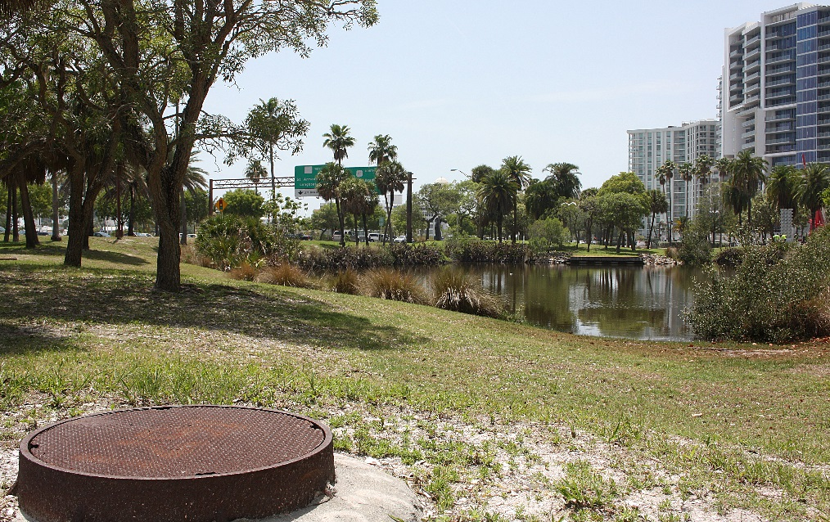
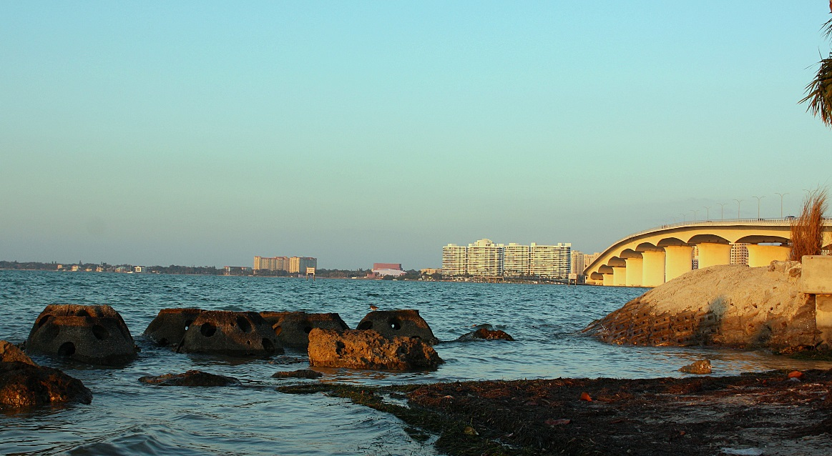
Step 5 – Identify Adaptation Strategies
Measures developed for eighty (80) assets deemed most vulnerable or critical

Slide 28
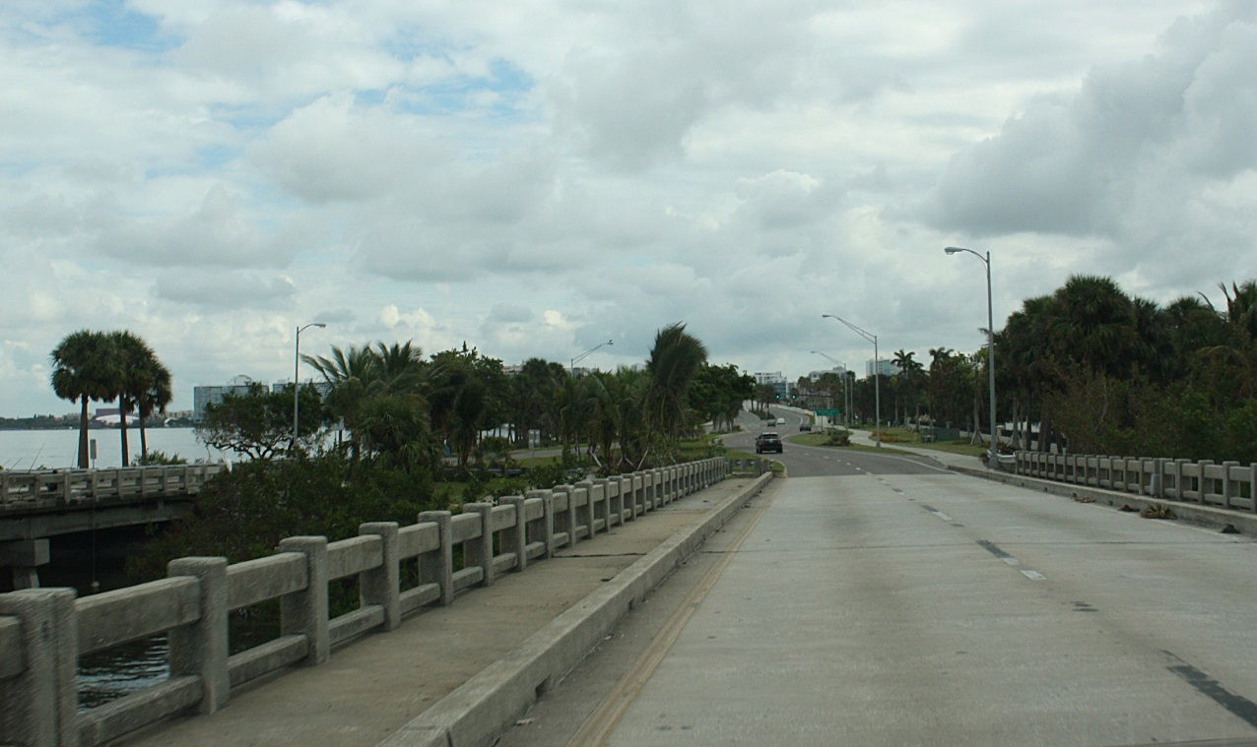
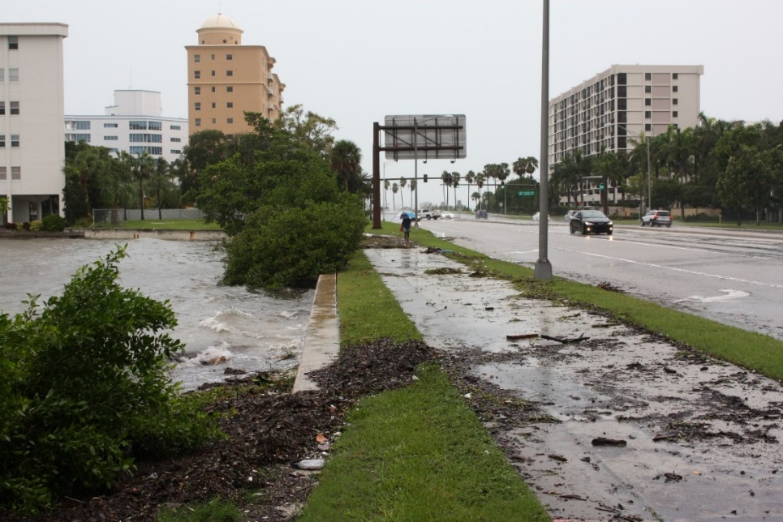
Transportation Vulnerabilities
King Tides and sunny day flooding
Flooded emergency evacuation routes
Flooded bridge approaches and causeways
Wind (lateral/uplift forces) on bridges
Wave energy on bridges and seawalls
Storm surge in boat basins
City/public boat launch for emergency vehicles
Pedestrians use decreases due to heat
Salt corrosion
Public safety
Landscape mortality from heat, salt, drought
UHI effect (more asphalt; more heat)
Notes:
These are all the ways we identified our transportation assets were vulnerable….

Slide 29
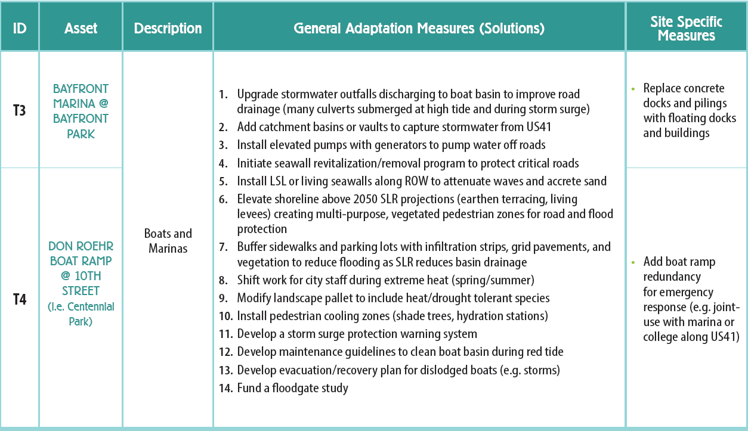
Transportation Adaptation Measures
Notes:
Here are two examples of the asset and then the adaptation measures (or solutions). There are also site specific solutions in addition to general ones. There are menu of options….

Slide 30
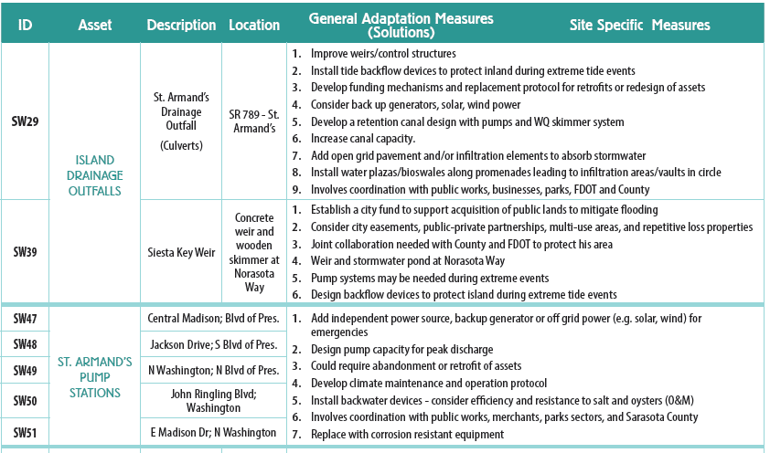
Stormwater Adaptation Measures

Slide 31
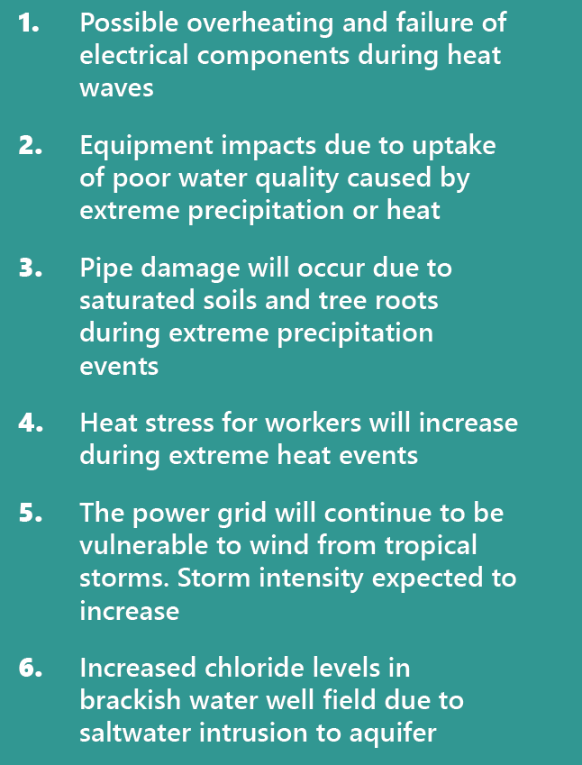
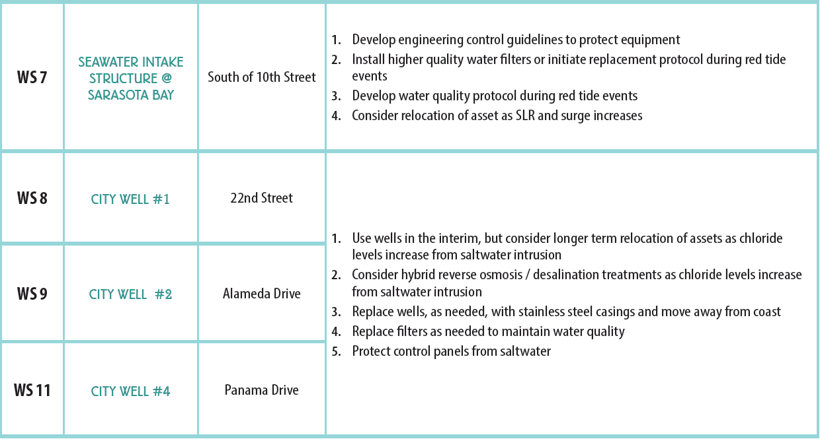
Water Supply Vulnerabilities and Adaptation Measures

Slide 32
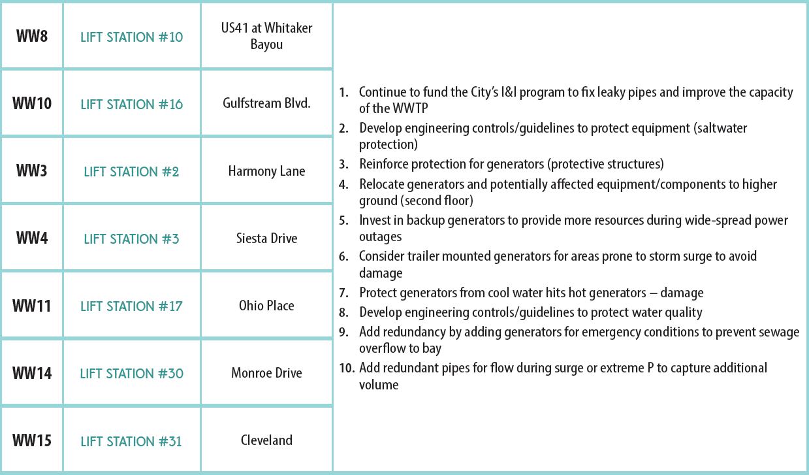
Wastewater Adaptation Measures

Slide 33
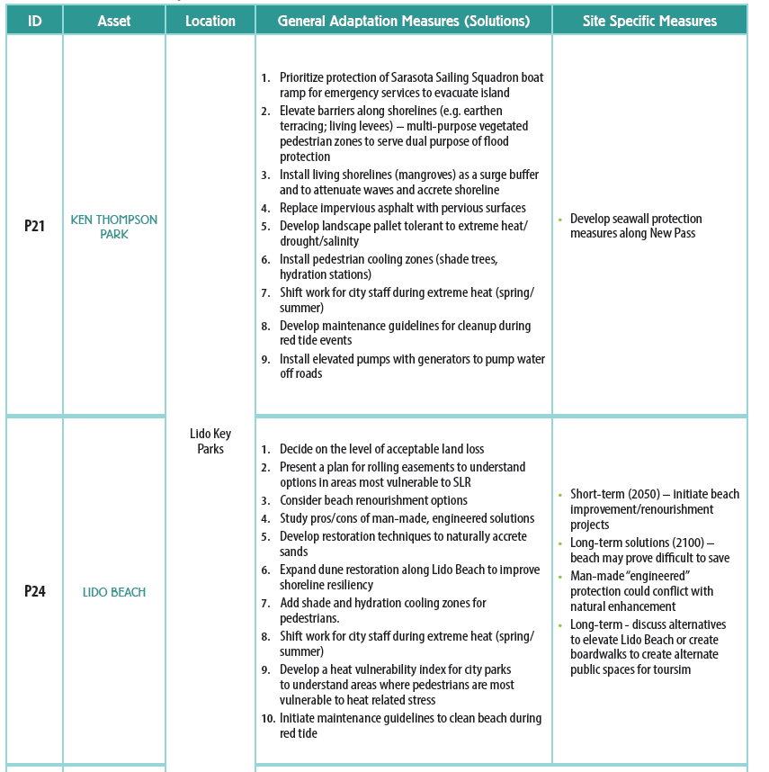
Public Lands Adaptation Measures

Slide 34
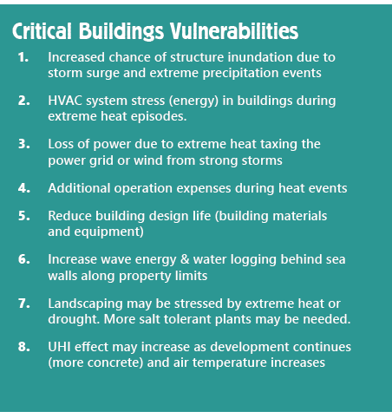
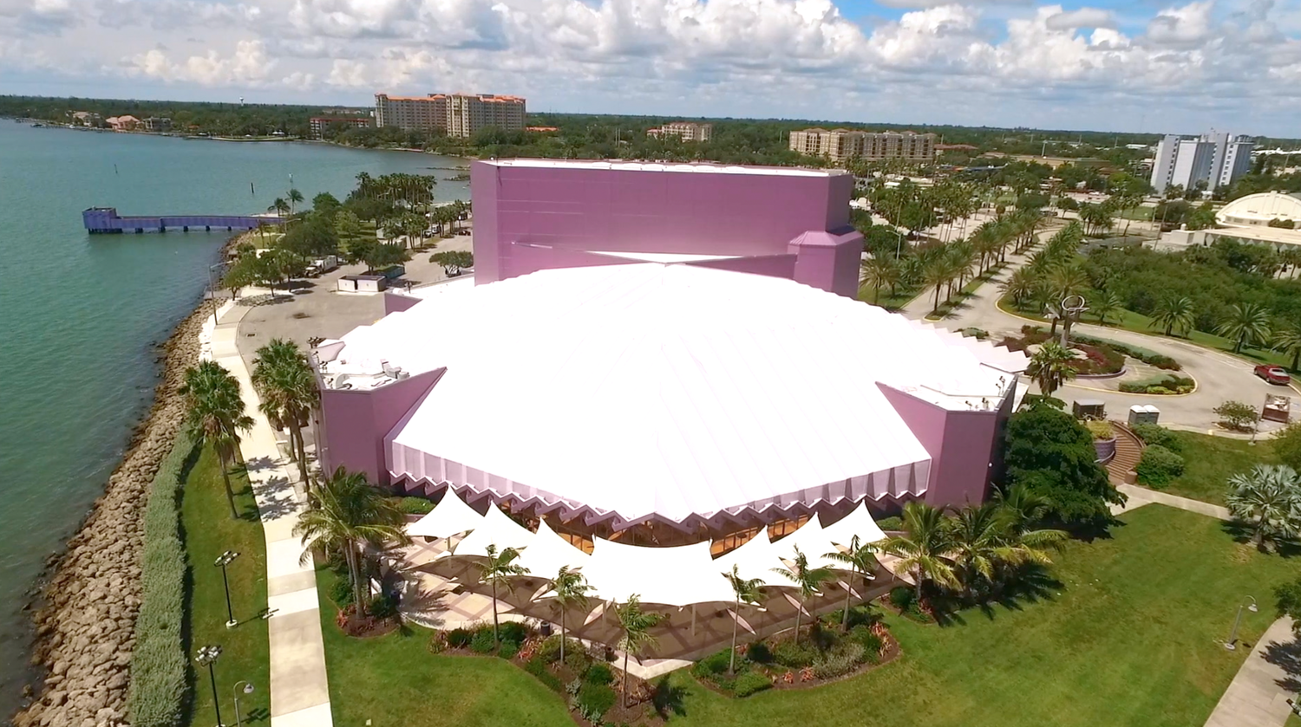

Slide 35
Critical Buildings Adaptation Measures

Slide 36
Step 6 – Adaptation Plan
Draft Final Adaptation Plan
Public Comment Nov. 13-27th
http://www.sarasotafl.gov/SGC
Presented Plan to City Commission
December 4, 2017
Publish Final Adaptation Plan in January 2018

Slide 37
Adaptation Plan
Recommendations
❶Integrate the Adaptation Plan recommendations based on direction from the Sarasota City Commission to “utilize scientific climate data to better predict future impacts to Sarasota”.
❷Integrate climate projections into CIPs, RFPs and RFQs
❸Support drainage model revisions that incorporate SLR, storm surge and extreme precipitation.
❹Identify funding for climate resiliency and hazard mitigation
❺Establish a city fund to acquire public lands for habitat protection, stormwater management, and green/blue infrastructure projects.
Photo| Sherri Swanson

Slide 38
Adaptation Plan
❻Evaluate opportunities to implement public assessments to fund climate resiliency projects that protect public infrastructure assets and public lands.
❼Develop a Heat Vulnerability Index.
❽Develop a Regional Climate Council that combines intergovernmental coordination and the private sector to encourage partnerships that can work to solve the challenges of climate change.
❾Expand the Adaptation Study to identify opportunities for greater resiliency across business districts, neighborhoods, and industrial areas.
❿Utilize the City of Sarasota Sustainability Department to facilitate implementation of these goals.
Photo| Sherri Swanson

Slide 39
Stevie Freeman-Montes
City of Sarasota Sustainability Manager

