Slide 1
Zika Virus
Anna M. Likos, MD, MPH
State Epidemiologist
Interim Deputy Secretary for Health
Florida Department of Health
December 7, 2016
Notes:
For medical audiences, have print outs of the following documents for distribution:
Zika Fever: Guidance for Physicians and Healthcare Providers
www.floridahealth.gov/zika
Zika Fever: Information for Clinicians
www.floridahealth.gov/zika
Zika Fever: Information for Obstetricians
www.floridahealth.gov/zika
Mosquito Bite Protection in Florida
www.floridahealth.gov/zika
Update: Interim Guidelines for Health Care Providers Caring for Pregnant Women and Women of Reproductive Age with Possible Zika Virus Exposure — United States, 2016
www.cdc.gov/zika/hc-providers/index.html
Interim Guidelines for the Evaluation and Testing of Infants with Possible Congenital Zika Virus Infection — United States, 2016
www.cdc.gov/zika/hc-providers/index.html
Interim Guidelines for Prevention of Sexual Transmission of Zika Virus — United States, 2016
www.cdc.gov/zika/hc-providers/index.html

Slide 2
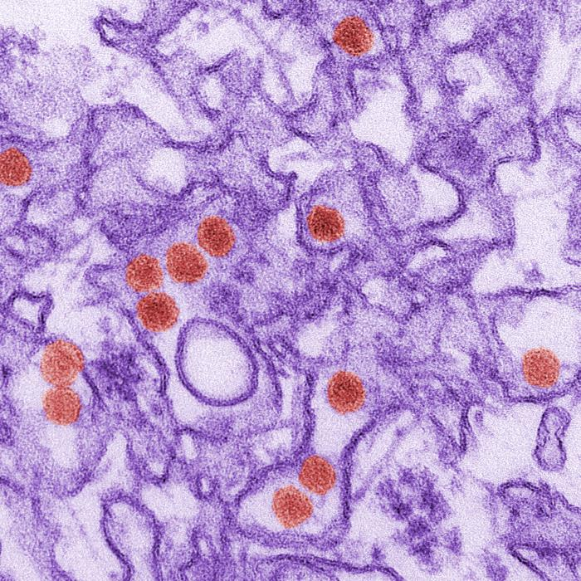
Zika

Slide 3
Zika Virus
Flavivirus:
  Antibody testing has cross-reactivity with related flaviviruses: Dengue, West Nile, Yellow Fever, Japanese Encephalitis
Distribution:
  Uganda’s Zika Forest 1947, then outbreaks Western Pacific Region 2007
  Currently 48 countries/territories in the Americas Region
Transmission
  Primarily, mosquito – Aedes aegypti, possibly Aedes albopictus
  Maternal-fetal (intrauterine or perinatal)
  Sexual
  Lab exposures
  Transfusion and theoretically, organ/tissue transplant and fertility treatment
  Detected in breast milk, saliva and urine but no documented transmission to date
Notes:
Flavivirus - 1st isolated in Uganda in 1947 from a Rhesus macaque in Zika Forest. Isolated during a study on yellow fever. Present in Africa and SE Asia – represent two main lineages of the virus. Only total 14 human cases identified in these areas and several countries only have evidence of transmission from serosurvey data. In East Africa – sylvatic cycle between nonhuman primates and several Aedes mosquito species. Humans are the primary amplifying host during outbreaks.
Aedes aegypti believed to be primary vector and other Aedes species have played important roles during recent Western Pacific outbreaks. Aedes albopictus may have the potential to transmit.
2007 – 1st major outbreak on island of Yap in Micronesia. Over 100 confirmed and probable (49+59=108) and 72 suspected = 180). Seroprevalence study (74% pos) estimated that around 73% (over 5,000) of the population had been infected and only 18% had a clinical illness (900).
2013 – outbreak in French Polynesia . Since then, spread to other Pacific Islands, with over 30,000 suspected cases.
Mosquito, perinatal, potential blood transfusion, evidence of sexual transmission – male to female and female to male described too– viral RNA detected in semen. Zika virus RNA has been identified in 3% of asymptomatic blood donors during an ongoing outbreak in French Polynesia.

Slide 4
Incubation and Viremia
Incubation period generally 3-14 days
Viremia ranges from a few days to one week
Virus generally detectable in blood for 7 days after symptom onset
Virus generally detectable in urine for 14 days after symptom onset
Virus has been detected in semen up to 6 months

Slide 5
Zika Fever Clinical Presentation
1 in 5 people infected will become symptomatic
Presentation similar (but milder) to other arboviral diseases common in same endemic areas
Differential: Dengue, Chikungunya, Leptospirosis, Malaria, Rickettsia, Rubella, Measles, Group A Strep, Parvovirus, Enterovirus, Adenovirus
Most common signs and symptoms:
Fever (often low-grade)
Maculopapular rash
Arthralgia
Conjunctivitis
Myalgia
Headache
Retro-orbital pain
Vomiting
Notes:
Causes an illness similar to dengue, but the symptoms are milder. Illness characterized by low-grade fever, maculopapular rash (face, neck, trunk, and upper arms, which may spread to the palms and soles), arthralgia, myalgia, and conjunctivitis.
Approximately 25-35% of cases may be afebrile.
Symptoms resolve over 4-7 days.
Severe disease requiring hospitalization is uncommon and case fatality is low.
Signs and symptoms in red box represent the most common found in patients with Zika.
Based on the typical clinical features, the differential diagnosis for Zika virus infection is broad. In addition to dengue, other considerations include leptospirosis, malaria, rickettsia, group A streptococcus, rubella, measles, and parvovirus, enterovirus, adenovirus, and alphavirus infections (e.g., Chikungunya).

Slide 6
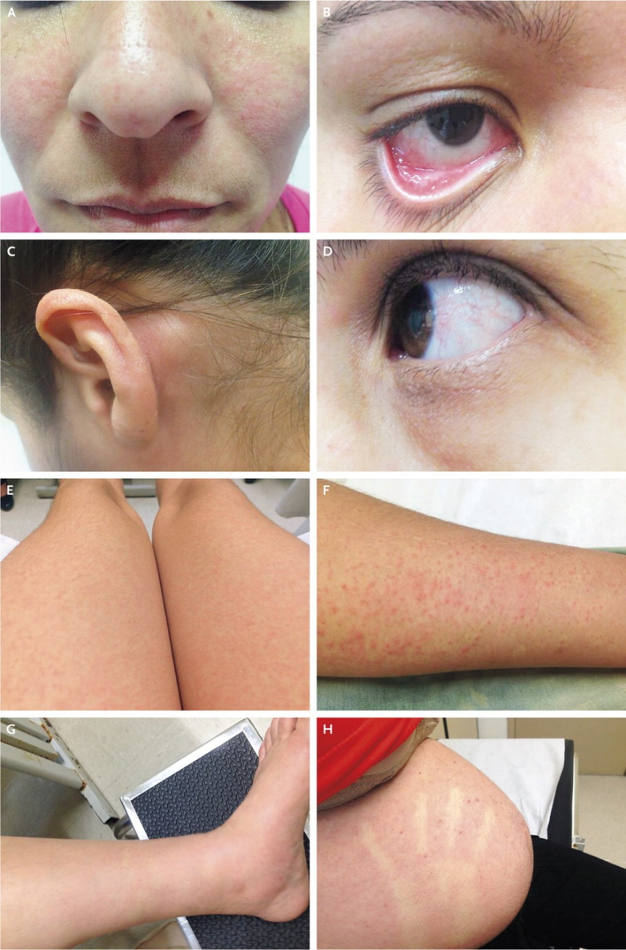
Zika Fever Clinical Signs
From: Brasil P et al.
N Engl J Med 2016. DOI: 10.1056/NEJMoa1602412

Slide 7
Zika Fever (continued)
Symptomatic treatment
  Typically resolves within a week
  Coinfections with other flaviviruses possible and should be considered, so avoid aspirin and similar drugs (e.g., NSAIDs)
Severe disease requiring hospitalization is uncommon and fatalities are rare
Infection during pregnancy (especially in first and second trimesters) is associated with microcephalic infants and/or other poor pregnancy outcomes
Increasing evidence of association with Guillain-Barré Syndrome (GBS) post infection
Notes:
Because of similar geographic distribution and symptoms, patients with suspected Zika virus infections also should be evaluated and managed for possible dengue or chikungunya virus infection. Aspirin and other non-steroidal anti-inflammatory drugs (NSAIDs) should be avoided until dengue can be ruled out to reduce the risk of hemorrhage.
Few reports of severe disease: Guillain-Barre, meningoencephalitis, autoimmune complications. However, there have been cases of Guillain-Barre syndrome reported in patients following suspected Zika virus infection. 74 patients in the French Polynesia outbreak had presented neurological syndromes or auto-­immune syndromes after the manifestation of symptoms consistent with Zika virus infection.
In July 2015, Brazil reported the detection of patients with neurological syndromes who had recent history of Zika virus infection in the state of Bahia. There were 76 patients with neurological syndromes identified, of which 42 (55%) were confirmed as GBS. Among the confirmed GBS, 26 (62%) had a history of symptoms consistent with Zika virus infection. Now they are up to 121 suspected cases. In January 2016, El Salvador reported the detection of an unusual increase of GBS since early December 2015. On average, El Salvador records 14 cases of GBS per month (169 cases per year), however, between 1 December 2015 and 6 January 2016 there were 46 GBS recorded, of which 2 died.
Another flavivirus, dengue virus:
Perinatal DENV transmission can occur, and peripartum maternal infection may increase the likelihood of symptomatic infection in the newborn. Dengue can have harmful effects that include death of the unborn baby, low birth weight, and premature birth. DENV may also be transmitted through breast milk.
Based on the typical clinical features, the differential diagnosis for Zika virus infection is broad. In addition to dengue, other considerations include leptospirosis, malaria, rickettsia, group A streptococcus, rubella, measles, and parvovirus, enterovirus, adenovirus, and alphavirus infections (e.g., Chikungunya).
Perinatal DENV transmission can occur, and peripartum maternal infection may increase the likelihood of symptomatic infection in the newborn. Dengue can have harmful effects that include death of the unborn baby, low birth weight, and premature birth. DENV may also be transmitted through breast milk. Most CHIKV infections that occur during pregnancy will not result in the virus being transmitted to the fetus. However, when intrapartum transmission occurs, it can result in complications for the baby, including neurologic disease, hemorrhagic symptoms, and myocardial disease. There are also rare reports of spontaneous abortions after maternal CHIKV infection.
Because of similar geographic distribution and symptoms, patients with suspected Zika virus infections also should be evaluated and managed for possible dengue or chikungunya virus infection. Aspirin and other non-steroidal anti-inflammatory drugs (NSAIDs) should be avoided until dengue can be ruled out to reduce the risk of hemorrhage.

Slide 8
Recommendations for Testing
Guidance is subject to change
At least one symptom (fever, rash, joint pain, red eyes) during/within two weeks of travel to areas with ongoing Zika virus transmission
Pregnant women with/without symptoms should be tested if travel to or reside in endemic areas (including areas of concern in FL)
Suspect local cases
  Common differential diagnoses have been ruled out
  Three of the four major symptoms
  Epi-linked to a confirmed or probable case (e.g., a household or other close contact)
Notes:
Guidance is subject to change as evidence and understanding of the disease and its complications are better understood
SYMPTOMS!!! Are fever, rash, joint pain and/or conjunctivitis (red eyes)

Slide 9
Laboratory Testing
Commercial testing now available for PCR and IgM
rRT-PCR detects virus in serum < 7 days and/or urine samples < 14 days after illness onset
Serology for IgM and neutralizing antibodies in serum collected > 4 days and up to 12 weeks after illness onset
Plaque reduction neutralization test (PRNT) for virus-specific neutralizing antibodies done at CDC
  Addresses cross-reactivity with related flaviviruses
  Serum sample collected ≥ 4 days of illness onset
  Convalescent specimen may be needed
Notes:
Commercial testing is available.
PRNT -Plaque Reduction Neutralization Test) used to quantify the titre of antibody necessary to neutralize a virus
IgM (Immune Globulin M) Antibody that represents acute or recent infection
4-fold rise in virus-specific neutralizing antibodies in paired sera. Immunohistochemical staining (IHC) for viral antigens or RT-PCR on fixed tissues
Difficult to distinguish infecting virus in people previously infected with or vaccinated against a related flavivirus
Neutralizing antibody testing may discriminate between cross-reacting antibodies in primary flavivirus infections (West Nile, dengue, yellow fever, chikungunya)
Antibody testing looks for immunological memory in your body (exposed to a virus/bacteria)
Antigen testing looks for the presence of the virus/bacteria in your body
PCR (Polymerase Chain Reaction)

Slide 11
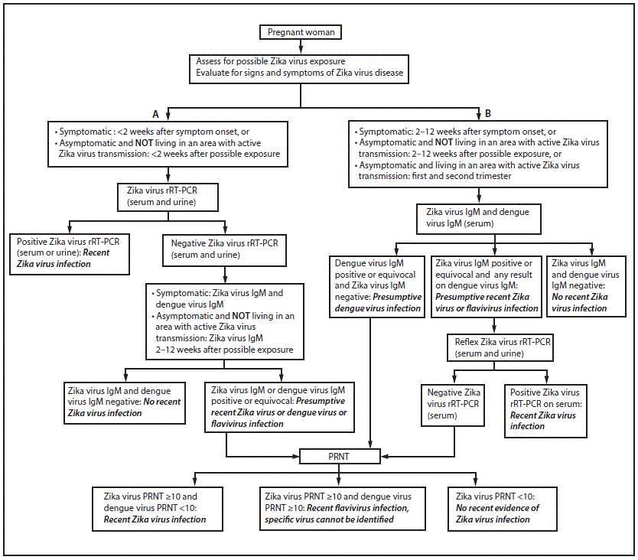
Testing/Interpretation for Pregnant Women with Possible Exposure to Zika Virus – United States
http://www.cdc.gov/mmwr/volumes/65/wr/mm6529e1.htm?s_cid=mm6529e1_e
Notes:
Update:
Interim Guidelines for Health Care Providers Caring for Pregnant Women and Women of Reproductive Age with Possible Zika Virus Exposure — United States, 2016
HAN (8/1/2016) CDC Guidance for Travel and Testing of Pregnant Women and Women of Reproductive Age for Zika Virus Infection Related to the Investigation for Local Mosquito-borne Zika Virus Transmission in Miami-Dade and Broward Counties, Florida http://emergency.cdc.gov/han/han00393.asp

Slide 12
Testing (continued)
All persons with positive lab results for Zika need to be reported to public health regardless of symptoms
Pregnant women who meet the criteria for testing but cannot obtain testing by a commercial lab (e.g., uninsured or under-insured) may be referred to the county health department (CHD) for testing
Pregnant women who do not meet the criteria for testing (no exposures or symptoms) but still request testing, may be referred to the CHD for testing after discussing the risks and benefits of testing

Slide 13
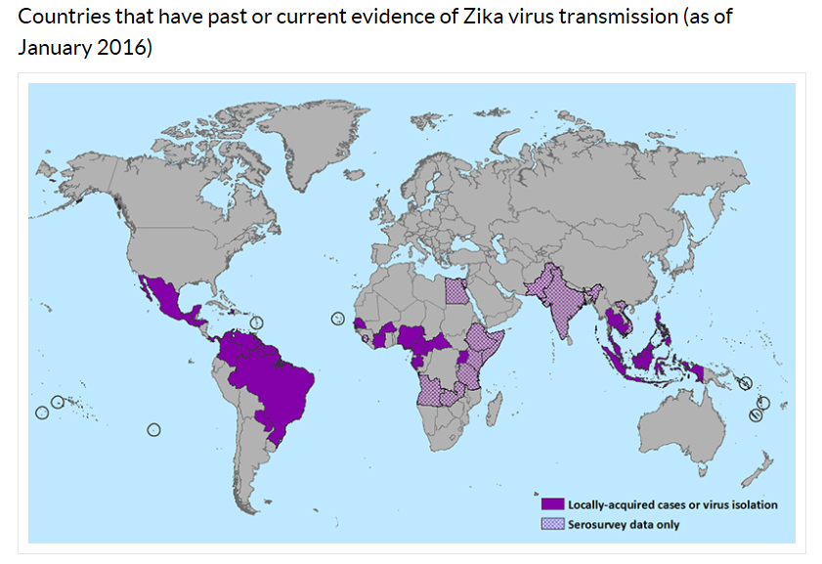
Zika Fever Distribution
Courtesy of CDC.
Notes:
Spread to the Americas in 2015. First locally acquired cases were identified in Brazil, Pan American Health Organization sent out an alert about the cases in May. Since then, locally acquired cases have been identified in Brazil, Colombia, Suriname, Venezuela, French Guiana, Guyana, Paraguay, El Salvador, Guatemala, Honduras, Panama, Mexico, Martinique, Puerto Rico, and Haiti. 20 countries or territories in the Americas, including Puerto Rico
Zika virus infections have been reported in travelers returning to the United States. From 2011–2014, 11 laboratory-confirmed Zika virus disease cases identified in travelers returning to the U.S. from areas with local transmission.
Se next slide for U.S., situation

Slide 14
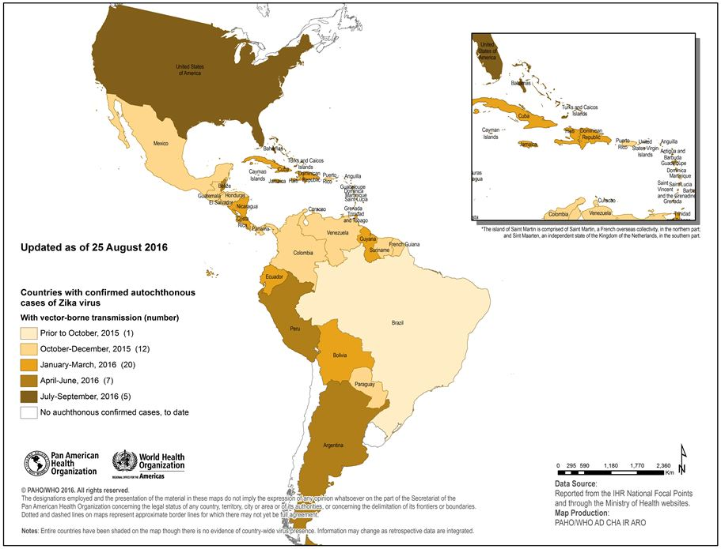


Countries and territories in the Americas with confirmed autochthonous (vector-borne) Zika virus cases, 2015-2016
Notes:
Due to concerns of microcephaly associated with maternal Zika virus infection, fetuses and infants of women infected with Zika virus during pregnancy should be evaluated for possible congenital infection and neurologic abnormalities.
The full spectrum of outcomes that might be associated with Zika virus infection during pregnancy and the factors that might increase risk to the fetus are not yet fully understood. Health authorities in Brazil, with assistance from the Pan American Health Organization, CDC, and other agencies, have been investigating the possible association between Zika virus infection and microcephaly in infants. However, additional studies are needed to further characterize this relationship. More studies are planned to learn more about the risks of Zika virus infection during pregnancy.
See PAHO update http://www.paho.org/hq/index.php?option=com_content&id=11599&Itemid=41691
CDC scientists tested samples provided by Brazilian health authorities from two pregnancies that ended in miscarriage and from two infants with diagnosed microcephaly who died shortly after birth. For the two full-term infants, tests showed that Zika virus was present in the brain. Genetic sequence analysis showed that the virus in the four cases was the same as the Zika virus strain currently circulating in Brazil. All four mothers reported having experienced a fever and rash illness consistent with Zika virus disease (Zika) during their pregnancies.

Slide 15
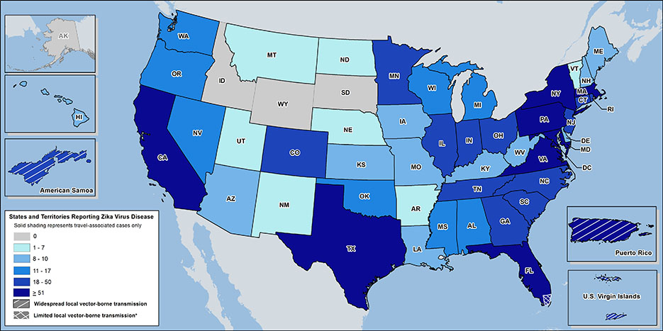
Zika Cases Reported in the United States
Laboratory-confirmed Zika virus disease cases reported to ArboNET by state or territory (as of August 3, 2016)
Courtesy of CDC.
Notes:
Non-travel related infections is 15 and all are in Miami-Dade and Broward County (See latest press release – This quote form 8-4-2016).
US States
Locally acquired mosquito-borne cases reported: 6
Travel-associated cases reported: 1,818
Laboratory acquired cases reported: 1
Total: 1,825
Sexually transmitted: 16
Guillain-Barré syndrome: 5
US Territories
Locally acquired cases reported: 5,525
Travel-associated cases reported: 23
Total: 5,548*
Guillain-Barré syndrome: 18
*Sexually transmitted cases are not reported for areas with local mosquito-borne transmission of Zika virus because it is not possible to determine whether infection occurred due to mosquito-borne or sexual transmission.

Slide 16
Florida Cases by County

Slide 17
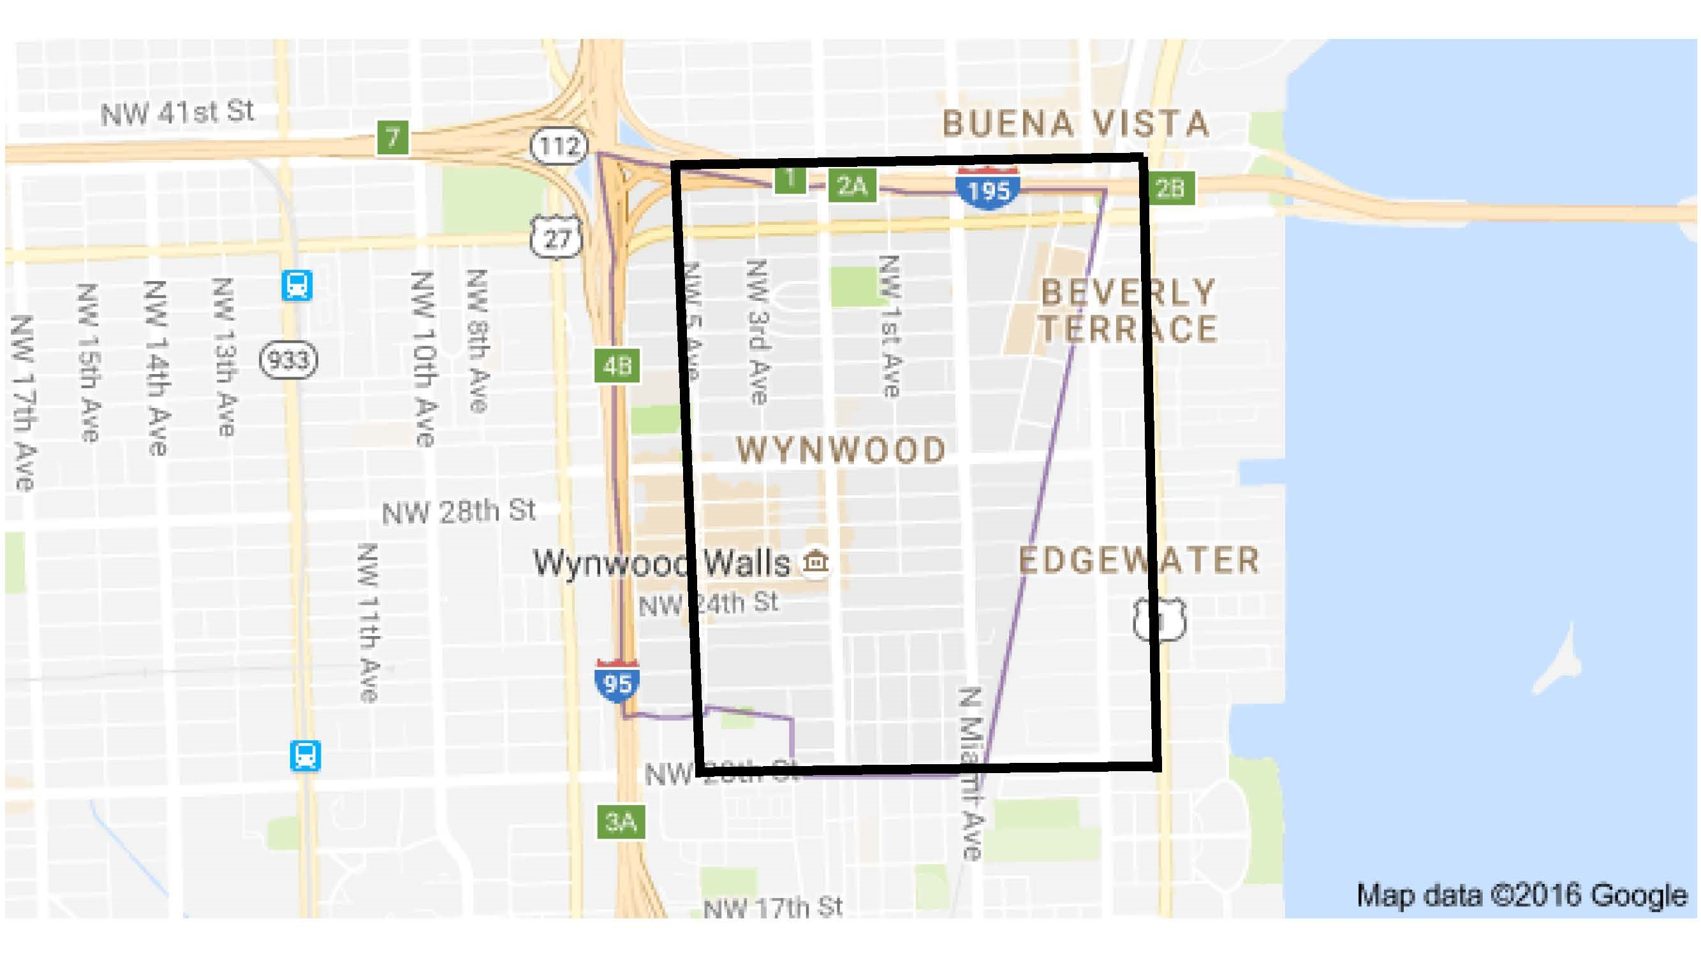
Local Transmission: July 29, 2016
July 29, 2016

Slide 18
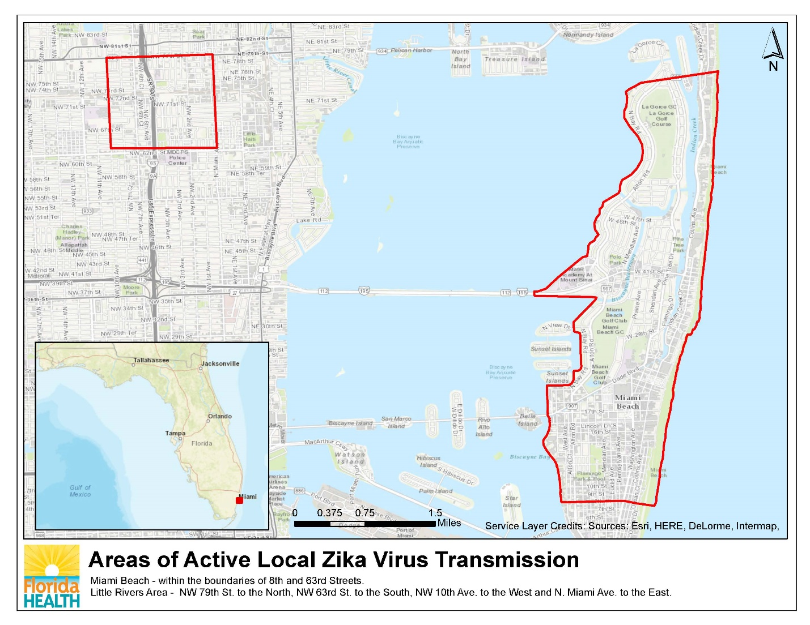
Designated Areas in Miami-Dade County

Slide 19
CDC Travel Alert/HAN
CDC recommends that women who are pregnant or thinking of becoming pregnant should avoid non-essential travel to areas with active Zika transmission
Pregnant women and their partners living in areas of active transmission should consistently follow steps to prevent mosquito bites and sexual transmission of Zika
For more information:
  http://www.cdc.gov/media/releases/2016/p0801-zika-travel-guidance.html
  http://wwwnc.cdc.gov/travel/notices
  http://emergency.cdc.gov/han/han00393.asp
  EpiCom
  Zika Virus Information Hotline is 1-855-622-6735
Notes:
Pregnant women in any trimester should consider postponing travel to the areas where Zika virus transmission is ongoing. Pregnant women who do travel to one of these areas should talk to their doctor or other healthcare provider first and strictly follow steps to avoid mosquito bites during the trip.
Women trying to become pregnant who are thinking about becoming pregnant should consult with their healthcare provider before traveling to these areas and strictly follow steps to prevent mosquito bites during the trip.
Avoid mosquito bites documents link http://www.floridahealth.gov/diseases-and-conditions/zika-virus/_documents/mos-prevention-qxp-02-16.pdf
Florida’s small case cluster is not considered widespread transmission, however, pregnant women are advised to avoid non-essential travel to the impacted area in Miami-Dade County (see map next slide). If you are pregnant and must travel or if you live or work in the impacted area, protect yourself from mosquito bites by wearing insect repellent, long clothing and limiting your time outdoors.

Slide 20
FL Status: December 6, 2016
1228 Total Cases
969 are travel-associated cases – in 38 Counties
  913 cases are in Florida residents
  56 cases are in non-Florida residents
  2 cases were sexually transmitted from persons who traveled
244 are locally acquired cases
  222 cases are in Florida residents
  22 cases are in non-Florida residents
15 had Florida and non-Florida exposures
  12 cases are in Florida residents
  3 cases are in non-Florida residents
178 are cases in women potentially infected during pregnancy
  154 cases are in Florida residents
  24 cases are in non-Florida residents
  108 women have delivered infants
  2 infants had congenital infections
  2 infants had microcephaly or other neurologic complications
1074 cases were symptomatic and 154 were asymptomatic
Notes:
http://www.floridahealth.gov/newsroom/2016/09/090116-zika-update.html
Miami/Broward/Palm Beach situation (Press release 9-1-2016)
DOH continues door-to-door outreach and targeted testing in Pinellas, Palm Beach and Miami-Dade counties and mosquito abatement and reduction activities are also taking place around the locations that are being investigated. (as of 9/1/16)
DOH believes ongoing transmission is only taking place within the small identified areas in Wynwood and Miami Beach in Miami-Dade County, see maps next slide.
The department is currently conducting 13 investigations. Information regarding the investigations can be found here. If investigations reveal additional areas of active transmission, the department will announce a defined area of concern. (detailed information in press release)

Slide 21
Figure 1: Zika Disease and Infection Cases (n=1224) in Florida as of 5 December 2016
Figure 2: Zika Disease and Infection Cases (n=1224) in Florida by symptom as of 5 Dec 2016

Slide 22
Florida Cases by Age Group

Slide 23
Florida Cases by Gender

Slide 24
Florida Cases by Race and Ethnicity

Slide 25
Suspect Zika Infection?
Infection with Zika should be suspected in:
All persons, including pregnant women, with two or more of the following signs/symptoms: fever, maculopapular rash, arthralgia or conjunctivitis (GBS could follow) and a history of travel to an area with Zika virus activity in the two weeks prior to illness onset
Mother of an infant or fetus with microcephaly or intracranial calcifications or other abnormalities, or poor fetal outcome diagnosed after the first trimester and history of travel to an area with Zika virus activity during pregnancy (Testing of both the mother and infant is recommended)
Notes:
https://www.flrules.org/Faw/FAWDocuments/FAWVOLUMEFOLDERS2016/4224/4224doc.pdf

Slide 26
Suspect Zika Infection?
Infants of symptomatic or asymptomatic pregnant women who traveled to an area reporting Zika virus activity while pregnant (testing of both mother and infant is recommended)
Suspect local cases in a county/area with no reported local Zika virus infections and three or more of the following signs/symptoms: fever, maculopapular rash, arthralgia or conjunctivitis
Suspected Zika virus associated GBS cases

Slide 27
Suspected Zika Fever Case Investigation
Sick person
Health care provider
Laboratory
State Laboratory
Case reported
Interview
County Health Department
Mosquito Control
Case finding
Outreach/education
Alerts/advisories
Testing Approval
Department of Health
State Office
Response
Subject Matter Experts
Policy Guidance
Case Consultation
Weekly reports
Publish statewide data
Public
CDC
27
Publish nationwide data
Notes:
Assess clinically compatible illnesses for possible travel-associated versus locally-acquired Zika virus infection:
Recent travel: specific dates and locations of travel in the two weeks prior to illness onset
No recent travel: any household contacts (household members or visitors) who have traveled one month prior to illness onset
All specimens that come to BPHL for Zika virus testing will also be tested for dengue and chikungunya and vice versa
If an individual is suspected of having Zika, the healthcare provider should contact their health department immediately upon suspicion to report the case and determine if the patient meets the CDC testing criteria. If they do, the CHD will work closely with the healthcare provider to collect the necessary samples and arrange for them to be sent to the Department Public Health Laboratory for testing. The CHD will also interview the patient to gather any additional information needed. The CHD will also notify the state office and their local mosquito control district of the case. Mosquito control will then provide outreach materials to the community on how they can protect themselves (drain and cover). Additional actions may include, conducting door-to-door inspections of mosquito prevention practices and abundance. The state office will add confirmed cases into the CDC national reporting system; Arbonet and include them the following weekly arbovirus report (available to the public by Tuesday).
This chart depicts the process for evaluation, diagnosis, and reporting, and the inherent complexities associated with any potential Zika case. The complex nature of this disease stresses the need of a coordinated approach between healthcare providers and public health.
Emergency Rules
64DER16-1 (64D-3.029) Diseases or Conditions to be Reported
Requires immediate reporting to DOH of suspected or confirmed cases of the Zika virus by physicians, hospitals, and laboratories
64DER16-2 (64D-3.040) Procedures for Control of Specific Communicable Diseases
Hospitals with suspected or confirmed cases of the Zika virus shall provide case status reports every 24 hours
Physicians with suspected or confirmed cases of the Zika virus shall provide case status reports every 72 hours

Slide 28
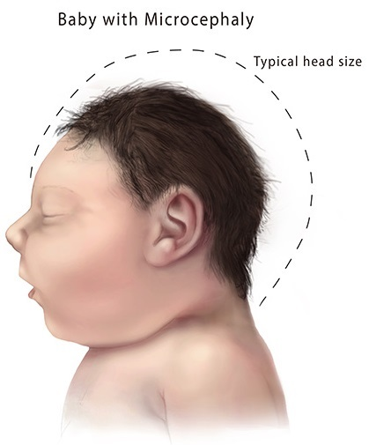
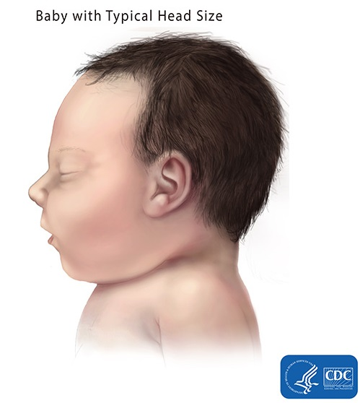
Zika Virus Link to Microcephaly?
http://www.cdc.gov/ncbddd/birthdefects/microcephaly.html
Notes:
Microcephaly is a neurological condition in which an infant’s head is significantly smaller than the heads of other children of the same age and sex, which can lead to developmental issues. Microcephaly can be caused by a variety of genetic and environmental factors, including some infections of the fetus during pregnancy such as toxoplasmosis, cytomegalovirus, rubella and chickenpox.
The Florida Birth Defects Registry reports that the rate of microcephaly in Florida is 6.8 cases per 10,000 live births, which is equal to ~150 cases per year in FL residents.

Slide 29
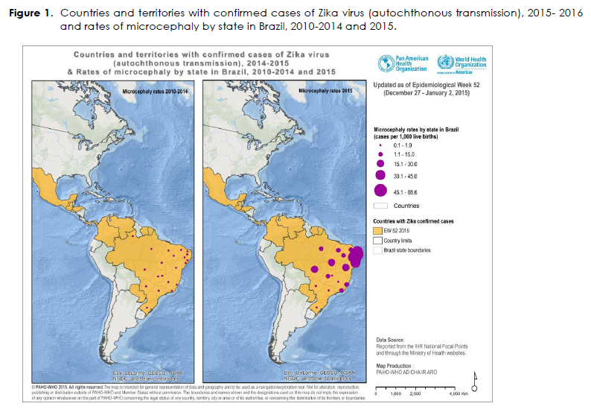
Courtesy of PAHO.
Notes:
Due to concerns of microcephaly associated with maternal Zika virus infection, fetuses and infants of women infected with Zika virus during pregnancy should be evaluated for possible congenital infection and neurologic abnormalities.
The full spectrum of outcomes that might be associated with Zika virus infection during pregnancy and the factors that might increase risk to the fetus are not yet fully understood. Health authorities in Brazil, with assistance from the Pan American Health Organization, CDC, and other agencies, have been investigating the possible association between Zika virus infection and microcephaly in infants. However, additional studies are needed to further characterize this relationship. More studies are planned to learn more about the risks of Zika virus infection during pregnancy.
According to Brazilian health authorities, as of epidemiological week 1 of 2016, there were 3,530 microcephaly cases recorded, including 46 deaths, in 20 states and the Federal District. Between 2010 and 2014, an average of 163 (Standard deviation 16.9) microcephaly cases was recorded nationwide per year.
CDC scientists tested samples provided by Brazilian health authorities from two pregnancies that ended in miscarriage and from two infants with diagnosed microcephaly who died shortly after birth. For the two full-term infants, tests showed that Zika virus was present in the brain. Genetic sequence analysis showed that the virus in the four cases was the same as the Zika virus strain currently circulating in Brazil. All four mothers reported having experienced a fever and rash illness consistent with Zika virus disease (Zika) during their pregnancies.

Slide 30
The Pregnancy Registry
Used to update recommendations for clinical care, to plan for services for pregnant women and families affected by Zika virus, and to improve prevention of Zika virus infection during pregnancy
Who is being monitored:
  Pregnant women in the United States with laboratory evidence of Zika virus infection (positive or inconclusive test results, regardless of whether they have symptoms) and prenatally or perinatally exposed infants born to these women.
  Infants with laboratory evidence of congenital Zika virus infection (positive or inconclusive test results, regardless of whether they have symptoms) and their mothers.

Slide 31
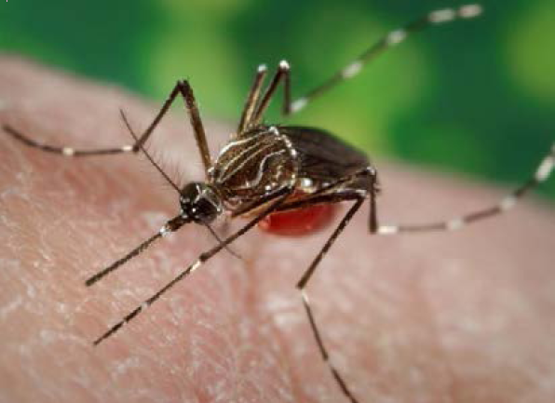
Mosquito Control
Aedes aegypti
Short distance flyer (<150 yards)
Closely associated with people and homes
Container breeders on household premises
Drain standing water at least weekly!

Slide 32
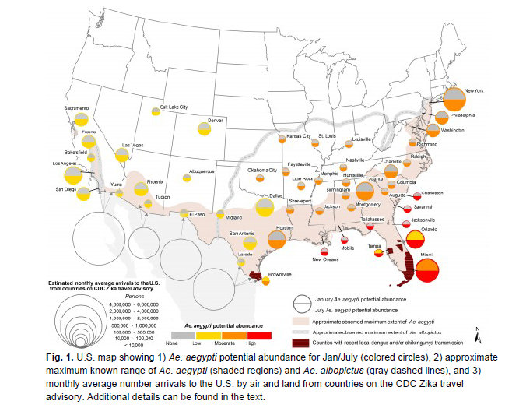
Vector Distribution
Monaghan AJ et al, 2016, PLoS Currents: Outbreaks.

Slide 33
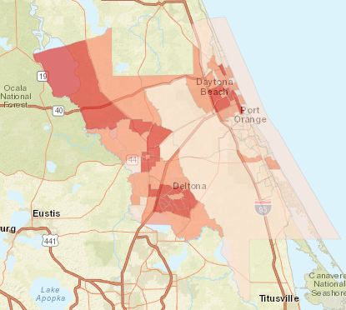
Getting the Message Out
At-risk populations identified as having outreach gaps during a past dengue outbreak:
  Non-white
  Do not speak English
  Living in poverty
Target outreach population: women of childbearing age (18-44 years)
Composite measure identifies high risk census tracts based on a combination of each of the four layers
http://arcg.is/23EyE3k

Slide 34
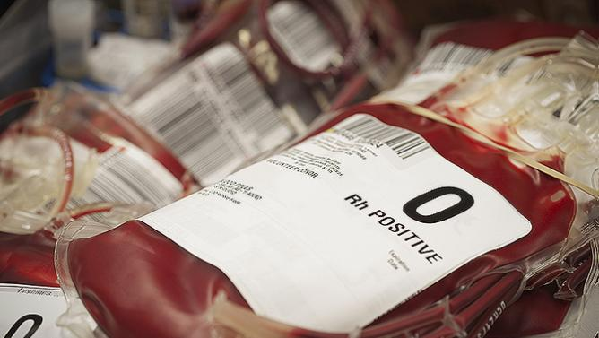
The Blood Supply
Many asymptomatic infections
Transfusion-acquired Zika virus infections reported outside U.S.
Florida blood bank representation on state Arbovirus Task Force: response plan for dengue and chikungunya updated
Share exposure site zip code for any local cases
Blood screening test on all products

Slide 35
Available Resources
Zika fever guidance document
Clinician one-pager
Information for obstetricians
Mosquito bite prevention in travelers handouts
FAQs document
DOH Zika Virus webpage: http://www.floridahealth.gov/diseases-and-conditions/zika-virus/index.html
CDC Zika Virus webpage: http://www.cdc.gov/zika/
Notes:
CDC and FDOH have released info for pregnant women and guidance for clinicians.
Blast fax to members of the American Congress of Obstetricians and Gynecologists members but we are also looking into other groups such as midwives.
Distribute to hospitals.

Slide 36
Mosquito Bite Prevention
DRAIN water from any containers where water has collected.
CLOTHING: If you must be outside when mosquitoes are active, cover up. Wear shoes, socks, long pants, and long sleeves.
REPELLENT: Apply mosquito repellent to bare skin and clothing. Always use repellents according to the label. Repellents with DEET, picaridin, oil of lemon eucalyptus, para-menthane-diol, and IR3535 are effective. Use netting to protect children younger than 2 months.
See: Mosquito Bite Protection in Florida
www.floridahealth.gov/zika

Slide 37
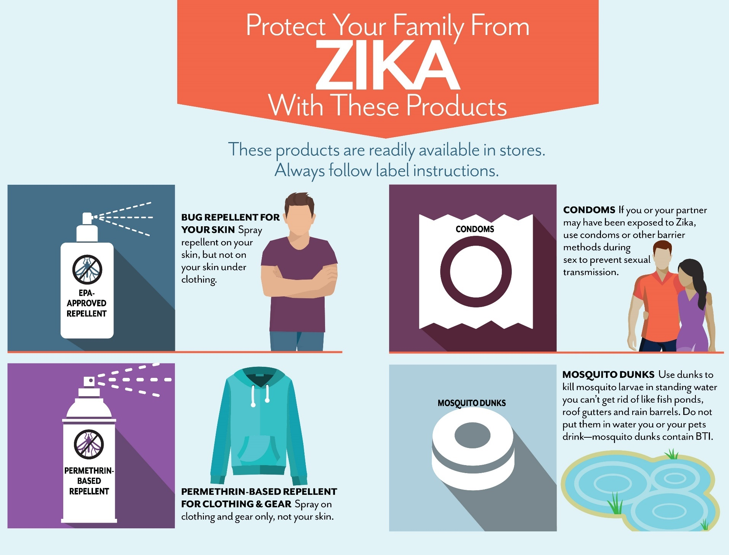

Slide 38


To Prevent Disease is Victory
To Cure Disease is Glory
Anna M. Likos, MD, MPH
State Epidemiologist and
Interim Deputy Secretary for Health
Email: Anna.Likos@FLHealth.gov
Phone: 850-245-4411

