Slide 1
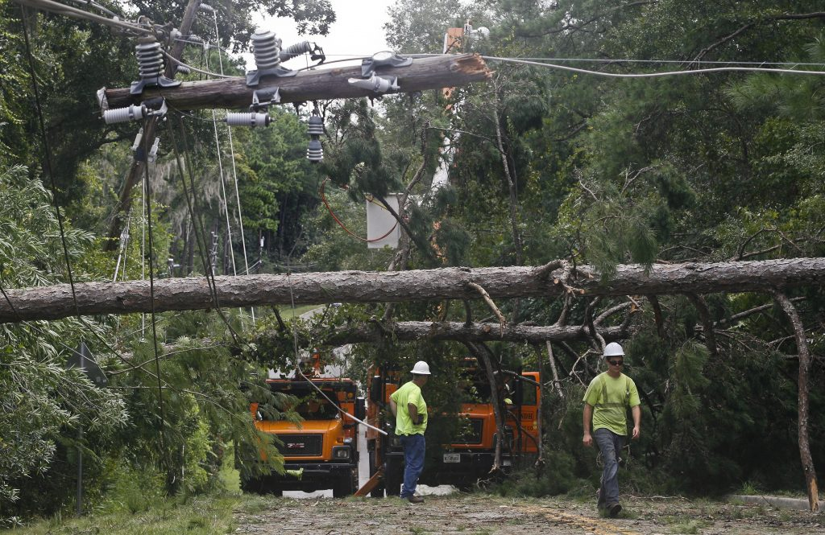
Notes:
Hurricane Hermine was the first to hit Florida in 11 years.
Prior to Sept. 2, Tallahassee had not been struck by a hurricane since 1985’s Hurricane Kate.
In June, at the start of the Atlantic hurricane season, local government officials and community partners hosted a press event encouraging residents to prepare. Additionally, City, County, area nonprofits and emergency management agencies coordinated a community safety fair with demonstrations, interactive exhibits and the distribution of resource and prep materials.
Hurricane Hermine was the worst natural disaster our community has faced. In just a few short hours, Hermine caused immense damage to homes, businesses and infrastructure. Tropical storm force winds with gusts up to 64 mph toppled hundreds of trees.

Slide 2
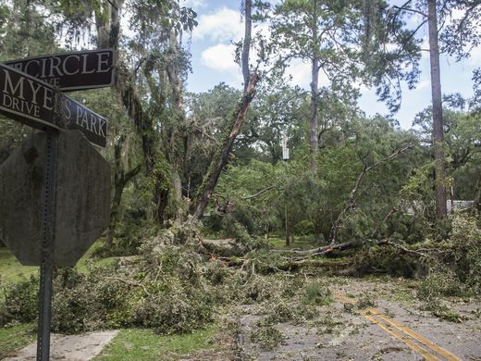
Impact
80 percent of the City’s electric distribution system damaged
75,000+ customers lost power
100s of roads blocked due to downed trees
276 of the 352 signalized intersections not operational
17 of the 38 transmission lines/elements damaged
8 of the 24 substations damaged
118 of the 160 circuits out
107 of the 107 sewage pumping stations lost power
26 of 26 water wells lost power
Manpower
9 mutual aid partners answered our call for help tripling the size of our electric line crew workforce
1,000 people worked, with some crews working around the clock in 16hr shifts
Materials
38,211 feet of wire replaced with new wire
17,279 sleeves used to splice existing wire together
107 poles of various sizes
588 lightening arrestors replaced
1,338 insulators replaced
8,033 fuses replaced
63 transformers replaced

Slide 3
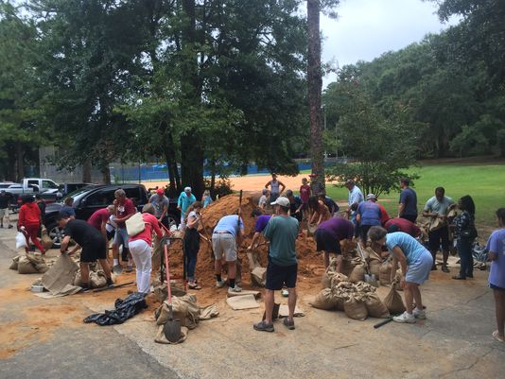
Notes:
Preparation efforts began well in advance of the storm’s landfall. Emergency Management teams began monitoring the storm in mid-August while the storm was off the coast of Africa. On August 30, coordination of a planned response began as reports called for Tropical Storm Hermine to move through Tallahassee. Communications efforts intensified with a focus on safety and preparedness.
The Emergency Operations Center (EOC) which is comprised of 22 distinct agencies began a partial activation on August 31 and was fully activated on September 1, operating for 111 consecutive hours.
Prior to August 31, Utilities had already reviewed mutual aid agreements to begin identifying resources including equipment and manpower from around the region that would enhance and accelerate recovery efforts. Mutual Aid with 5 other electric utilities were set in motion pre storm, with hotel rooms reserved and logistics set. The total number of mutual aid partners would ultimately increase to 9.

Slide 4
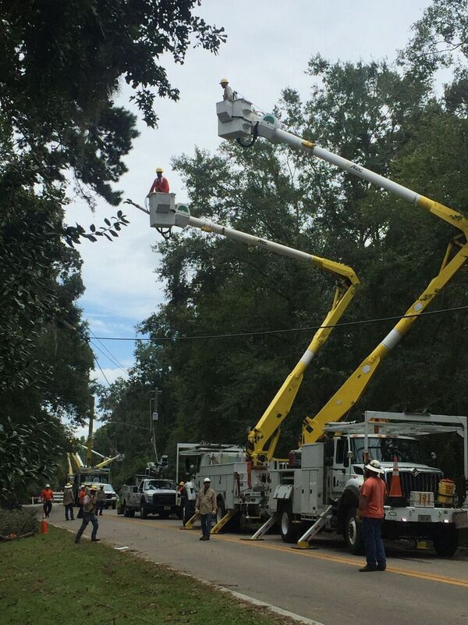
Unprecedented support from mutual aid partners
Crews worked around the clock
Debris Removal
Roadway Clearing
Traffic Signals
Generator Hook-ups
Electric Repair/Restoration
Notes:
Within 12-24 hours, mutual aid partners were onsite to assist with electric restoration efforts. Tallahassee received an unprecedented level of support from partners including Kissimmee, Orlando, Thomasville GA, Lafayette LA, Jacksonville Beach, Lakeland, Bartow and Gulf Power, which was coordinated with assistance from the Governor’s office.
Crews operated in shifts, day and night, to ensure their safety and the safety of others.
Simultaneously and with additional resources from the state and others, work began to clear debris, install generators for the traffic signals and waste water pumps.
Ultimately, more than 20,561 truckloads of debris was removed.

Slide 5
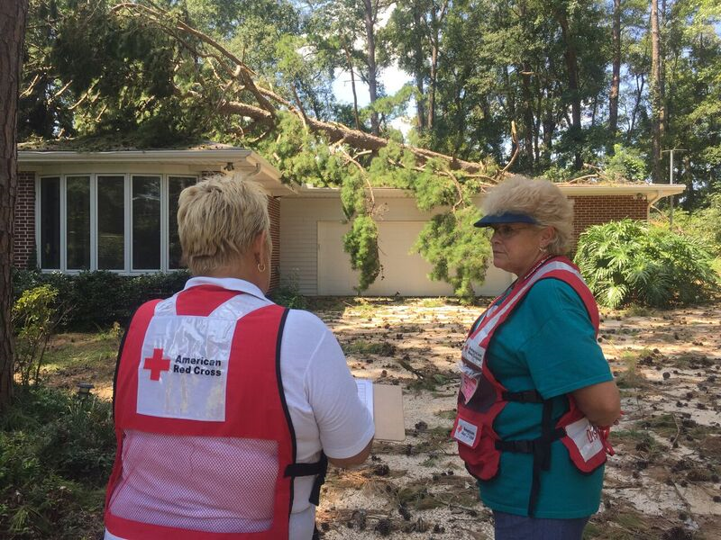
Multiple emergency shelters
Community centers, comfort stations, water distribution and hot meal sites
Ice, water and meals delivered to neighborhoods
Publix Supermarkets
Churches and neighbors opened their doors to those in need
No rise in crime.
Notes:
Multiple emergency shelters were opened in coordination with the Red Cross.
To provide additional relief to citizens without power and air conditioning, comfort stations, water distribution and hot meal sites at several locations throughout the community.
City officials, TPD and TFD teamed up with community leaders to deliver ice, water and meals to neighborhoods.
Publix Supermarkets were prepared and equipped with backup generation and welcomed residents inside to cool off and enjoy complimentary coffee.
Churches and neighbors opened their doors to those in need.
No rise in crime.

Slide 6
Notes:
Hospitals were up on Friday; Never lost power at TMH main facility.
FSU was restored on Saturday and all schools had power by Monday night.
Five days after the hurricane, more 90 percent of impacted customers had power.
The city of Tallahassee exceeded or was on par with the pace of similar efforts following a direct hit from a major storm.
This chart compares Tallahassee’s power restoration after Hurricane Hermine with other storms in Florida and the United States. Another Category 1 storm, Hurricane Irene, struck multiple states in 2011 and the power restoration for Irene took a little longer than efforts post-Hermine. One tropical storm took slightly less time, while as expected, Category 2 and 3 hurricanes in South Florida required more time to restore power.

Slide 7
Recovery
Navigation stations
Insurance claims; available resources; general questions
Waived fees
Growth management and building permit fees for storm-related repairs; Permit fees to remove storm-damaged trees were also waived.
Business outreach
Federal Major Disaster Declaration issued
Notes:
Navigation teams were established to assist residents with general information on processes such as filing insurance claims (e.g. types of documents you should have available when filing a claim); share information on resources to assist with emergency needs and recovery efforts; and provide information on permit fee waivers and other general questions that may arise.
Waived growth management and building permit fees for storm-related repairs. Fees were waived retroactively for completed projects. Permit fees to remove storm-damaged trees were also waived.
Government officials issued a letter to local cable and cell phone providers, as well as grocery store chains, asking our private sector community partners to provide some type of financial relief in the month of September in recognition of the hardship many of our residents have experienced.
On September 28, the Federal Emergency Management Agency issued a federal disaster declaration for Leon County. The declaration helped provide assistance to individuals and households in Tallahassee and Leon County. In addition, Leon County will receive assistance for emergency work and repair/replacement of disaster damaged facilities.

Slide 8
Despite being hit head on by a hurricane, Florida’s Capital City demonstrated unprecedented resiliency and was back up and running in a matter of days. Yet, there are lessons to be learned. We can and should do better in anticipation of the next disaster.
Enhance our system for communications and the sharing of information.
We must do a better job helping everyone understand the process for restoring power.
Acknowledge that the expectation for a constant stream of information has grown exponentially with the use of social media.
Notes:
Social Media (Aug. 31 - Sept. 5) - Potential reach of 14 million; nearly 40,000 incoming messages; over 3,000 new Twitter followers; over 2,000 new Facebook followers. Links to news releases on City’s website were clicked on nearly 10,000 times; nearly 4,000 mentions; nearly 2,600 retweets
Staff worked to prioritize responses to answer as many specific direct messages and questions as possible and to respond to critical incidents, like downed wires and trees impeding traffic. Like the call center, Twitter became a major vehicle for citizens to report concerns. While staff attempted to respond to as many citizen-specific concerns as possible, the focus was primarily on posting general information. The majority of incoming messages via social were: questions like “When will MY power be restored?” and “Where are crews working today?”
Overall, the sentiment of posts were mixed. Citizens were appreciative of crews working to restore power but, they were upset that the power had not been restored quickly enough.

Slide 9
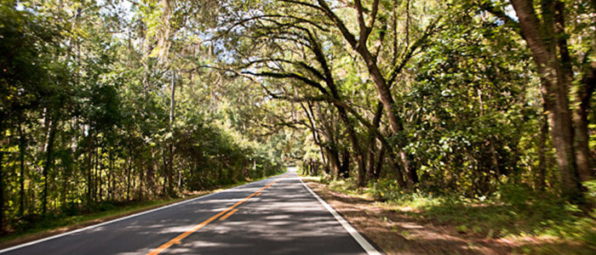
Strengthen relationships and communications with agencies that serve our vulnerable population.
Discuss and encourage back-up generation and/or quick connect options to support heating and cooling systems.
Establish a direct line of communication/point of contact during disasters.
Work more with neighborhoods and homeowner associations to ensure citizens are taking steps to prepare.
Examination of our High Priority restoration matrix.
Identify funding sources for storm hardening electric circuits.
Enhance electric reliability while
preserving our magnificent tree canopy.

