Slide 1
2016 Zika Case Response from a State Perspective
Adriane Rogers
Medical Entomologist
Entomology and Pest Control Section
Bureau of Scientific Evaluation and Technical Assistance
Division of Agricultural Environmental Services

Slide 2
On Feb 1st, The World Health Organization declared Zika a "public health emergency of international concern"
First 4 travel-associated cases in FL identified in late January

Slide 3
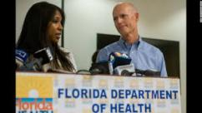
Public Health Emergency Declaration
Governor, Rick Scott signed Executive Order 16-29 (Feb. 3rd, 2016)
Directed State Surgeon General to declare public health emergency in Florida
4 counties with travel-associated ZikV cases
All new counties with confirmed cases to be listed
Currently up to 38 (Dec. 1, 2016)
Section 388.45(1), Florida Statutes
Notes:
The state health officer must then immediately notify the Commissioner of Agriculture of the threat to public health and he is then authorized to issue a mosquito declaration in those counties in need of additional mosquito control measures, as per FL Statute 388.45(1). Upon the identification of the first locally acquired case of Zika in Florida, Agricultural Commissioner, Adam H. Putnam issued a Mosquito Declaration for Florida on July 29. This was the first case of local Zika transmission in the Continental United States

Slide 4
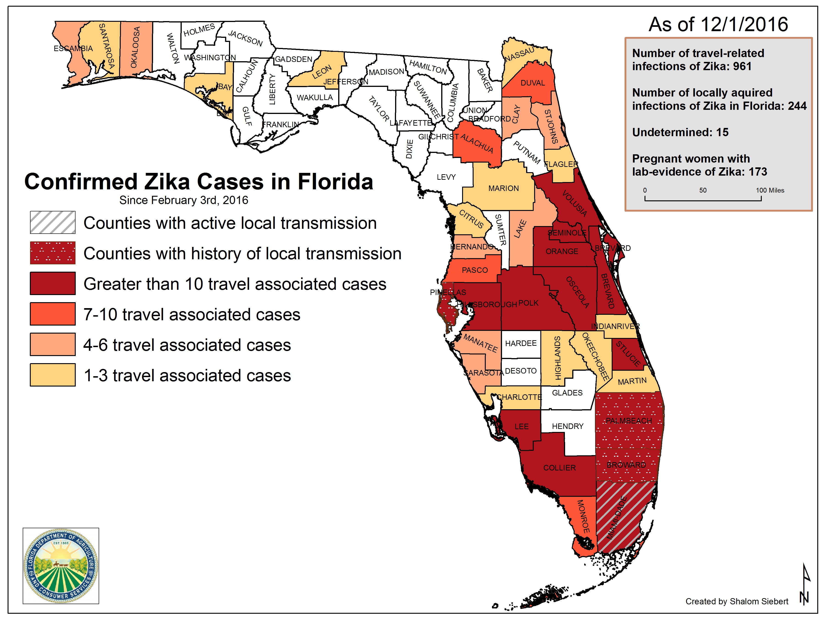
Notes:
This map shows Zika incidence as of yesterday (9/23/16) and shows the counties with confirmed, Zika cases. We are now up to 683 TRAVEL associated cases, 95 locally acquired cases (in 4 counties; Miami-Dade, Broward, Palm Beach, and Pinellas), 90 additional cases involving pregnant women, and 10 out of state cases (non-Florida residents) . Bringing the grand total of Zika cases in FL to 878! We are the only state in CONUS in which local transmission is occurring, meaning that our local mosquitoes are becoming infected from biting infected humans.

Slide 5
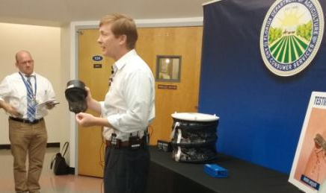
Mosquito Declaration
Commissioner of Agriculture, Adam H. Putnam, issued Mosquito Declaration on July 29, 2016
Following identification of first locally acquired cases in CONUS
3 areas of active transmission identified in Miami Dade county
Authorizes aggressive ameliorative mosquito control measures within minimum 200 yard radius for 45 days
Source reduction
Treating containers with long-lasting larvicide
Providing outdoor residual and spatial adulticide treatments
Conducting surveillance
Educating residents on ZikV and limiting exposure to mosquitoes
Section 388.45(1), Florida Statutes
Notes:
Upon the identification of the first locally acquired cases of Zika in Florida, Agricultural Commissioner, Adam H. Putnam issued a Mosquito Declaration for Florida on July 29. This was the first case of local Zika transmission in the Continental United States and since that time 2 areas of active transmission have been identified within Miami-Dade county. The Declaration was re-issued on Sept 9th and authorized additional aggressive ameliorative mosquito control measures to be conducted within a minimum of a 200-yard radius of a case patient’s home at a minimum of once per week for 45 days. Such additional aggressive measures include source reduction, treating habitats with long-lasting larvicides, performing adult mosquito control whether it be spatial or residual, conducting surveillance, and educating residents on Zika virus and limiting their exposure to mosquitoes.

Slide 6
Zika in Florida
Local transmission in CONUS
July 29th – original 2 mi² area in Wynwood identified (Miami-Dade county)
Since lifted following 45 d no new cases after Aug 5th
August 19th – new 1.5 mi² location on Miami Beach identified (M-D county)
Later expanded to 4.5 mi²
8 positive mosquito pools identified from Miami Beach collections
Collected 8/22, 8/23, 9/4, 9/9, 9/20, 9/23, and 10/5
All Aedes aegypti in BG Sentinel traps (BG lure, octenol, and CO₂)
October 13th – new 1 mi² location in Little River, Little Haiti (M-D county)
One offs – Broward, Palm Beach, and Pinellas Counties

Slide 7
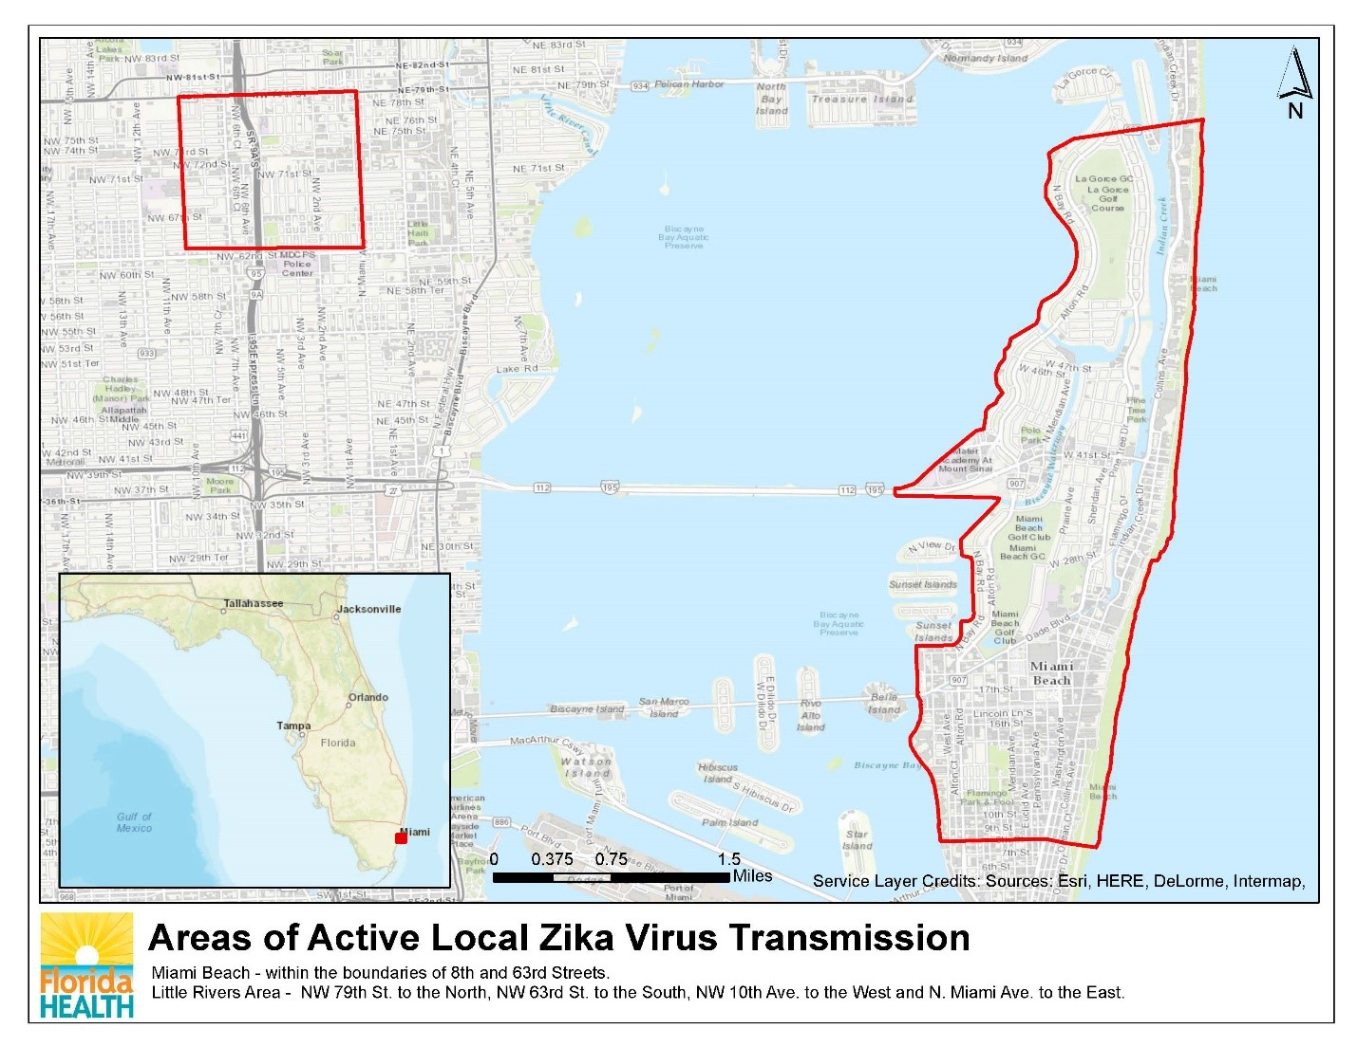

Slide 8
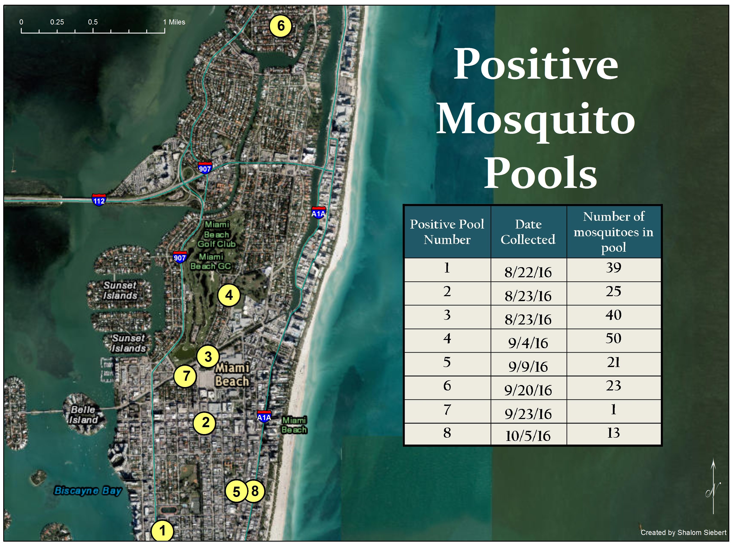
6
4
3
7
2
5
8
1
FGCU
Notes:
This map shows the locations of the positive mosquito pools collected on Miami Beach.

Slide 9
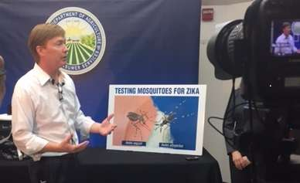
FDACS Role in Response
Department of Health = lead agency
FDACS’s role
Support to local MCPs & FDoH
Monitor local MCPs as they respond to cases
Identify resource needs and limitations of local MCPs
Supplement MCPs as necessary
Provide technical assistance to MCPs & FDoH
Facilitate sharing of mosquito control personnel/equipment between programs
Develop statewide control strategy
Task Force for open counties or limited programs

Slide 10
Outreach to Affected Counties
Host recurring call with affected counties
Open and maintain active lines of communication
Identify resource needs and limitations
Facilitate communication between programs
Sharing of mosquito control expertise
Initially 4 affected counties
Expanded to include all MCPs (April 25th!)
Notes:
We have been working with the mosquito control programs since we heard of the first case at the end of January and working with them very closely to ensure the proper control measures are being taken. Since the Monday following the Declaration, we’ve held a recurring conference call with the affected counties having confirmed cases. The purpose of this call is to open and maintain active lines of communication, identify resource needs and limitations the MCPs are facing, and one of the first things that really came out of the early meetings was that these calls served as a great forum to facilitate sharing of equipment or regional expertise. We expanded the call to include ALL MCPs on April 25th. FDoH and FDEP participate as well.

Slide 11
Technical Guidance & Outreach
Provide guidance and training on best management strategies
MCPs – Zika Workshops
9 regional meetings
PCOs – Zika Vector Control for the Urban Pest Management Industry
Co-hosted workshops with U Florida and FMEL
Bridge gap between public health mosquito control and pest control operators offering mosquito control services
Potential use as additional manpower in supplemental mosquito control response
Notes:
One of our main duties at the FDACS is to provide technical guidance to MCPs on best management strategies for combating these specific Zika vectors, which we will talk a little bit more about in a few minutes. We’ve held 9 regional workshops throughout FL in the past month for MCPs and local DoH.
We also held 2 workshops for pest control operators, first of which was held in Orlando back in April. Some Pest control operators offer mosquito control services to home owners, but they don’t specifically focus on these vector species. So this training event was designed to sort of bridge that gap between public health mosquito control and pest control companies who happen to offer mosquito control services as part of a contract for pest control around homes. There is a potential use for the pest control operators to be utilized as additional manpower in supplemental mosquito control response if needed.
And We’ve held a series of webinars like this one for Department of Health Environmental Health staff, Florida beekeepers, and national Emergency management folks.

Slide 12
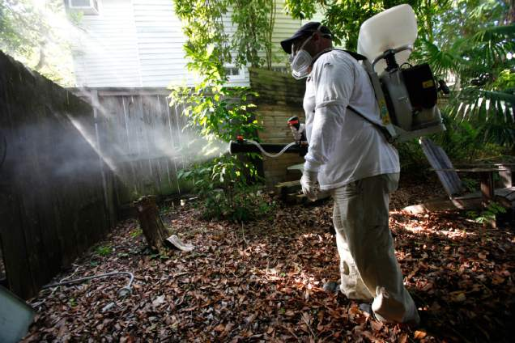
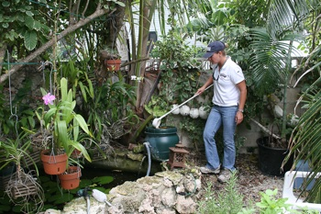
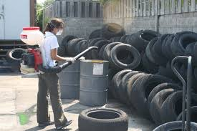
Zika Case Response
Controlling peridomestic species requires fully comprehensive Integrated Mosquito Management regime
Public education
Source reduction
Larviciding
Targeted adulticiding
Surveillance
Notes:
Controlling AAEG/ALBO absolutely requires a fully comprehensive, integrated mosquito management regime which includes public education, source reduction, pesticide application in larviciding, targeted adulticiding, and surveillance!! Pesticide applications will be performed by licensed applicator. If there is a local MCP in the county, they will be performing the applications. Otherwise we will be contracting this work out to a licensed professional.

Slide 13
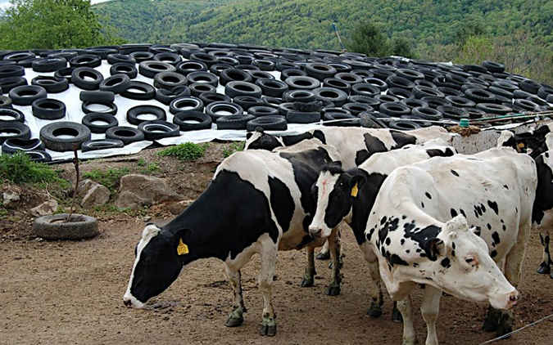
Technical Guidance & Outreach
Host educational Zika vector control webinars
DoH, Beekeepers, national EM, FFWCC
Educational materials for FDACS field personnel, beekeepers, and state emergency personnel
Education for farmworker community
Outreach to cattle/dairy operations
Use of waste tires to protect silage from elements
Outreach to lien holders of vacant/foreclosed properties

Slide 14
Need for Increased Surveillance
Identified need for targeted surveillance of peridomestic, container mosquitoes
MCPs in FL historically founded to combat pestiferous and long flight-range disease vectors
Interest in gathering data on current geographic distribution of Aedes aegypti and Aedes albopictus
Accurate distribution data critical
Predict outbreak occurrences
Identify areas requiring treatment to prevent outbreaks (hotspots of localized activity)
Evaluate response readiness
Monitor control efforts
Notes:
Very early on we identified the need for increased surveillance activities targeting Zika vectors so we purchased over 300 BG Sentinel Traps, which have been shown to be the most effective traps at collecting these particular mosquitoes. We outfitted our Bronson Animal Disease Diagnostic Laboratory in Kissimee to perform multiplex RT-PRC assays for rapid detection of not only Zika, but Dengue and Chikungunya viruses as well.

Slide 15
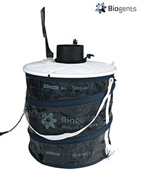
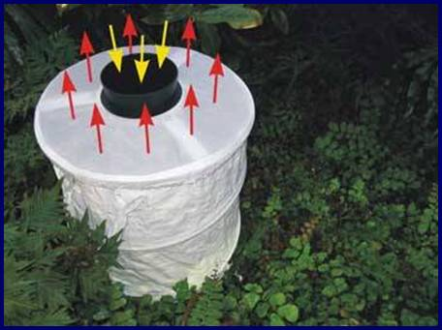
Need for Increased Surveillance
FDACS provided over 300 BG Sentinel Traps for adult collections to counties
Excellent surveillance tool for peridomestic species
Mimics human body convection currents
Releases artificial human skin and octenol lures through large surface area
Utilizes attractive visual cues
**Catches increased with CO₂

Slide 16
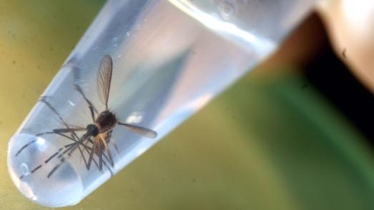
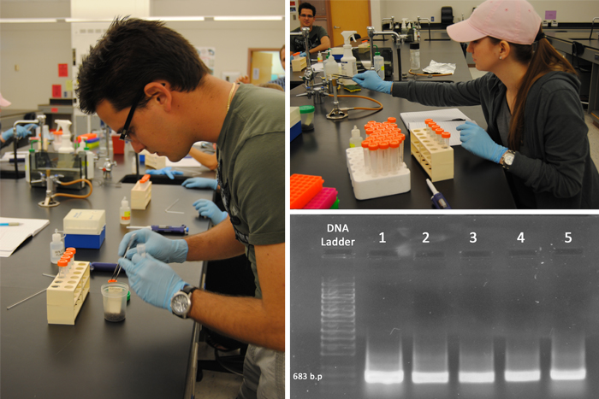
State Response
FDACS Bronson Animal Disease Diagnostic Laboratory (BADDL)
Multiplex RT-PCR assay for rapid detection of Zika, Dengue, and Chikungunya viruses
Provided protocol to counties
Encouraged counties to submit all Aedes aegypti & Aedes albopictus specimens collected to Kissimmee
Number of pools tested – over 5,836
Number of individual mosquitoes – over 76,889
Number of counties submitting samples – 35
(As of Dec. 1, 2016)
Notes:
Very early on we identified the need for increased surveillance activities targeting Zika vectors so we purchased over 300 BG Sentinel Traps, which have been shown to be the most effective traps at collecting these particular mosquitoes. We outfitted our Bronson Animal Disease Diagnostic Laboratory in Kissimee to perform multiplex RT-PRC assays for rapid detection of not only Zika, but Dengue and Chikungunya viruses as well.

Slide 17
State Response Plan/Local Aid
Implemented Incident Command Structure
Joint Task Force with FDoH
Scaleable to adapt to a changing role of FDACS
Develop control strategy for state level response to assist in situations where a program/county cannot properly respond
Is there a MCP or is it an open county?
Can they respond to suspect, travel-associated or locally-acquired cases?
Has the MCP reached their resource capacity?

Slide 18
State Response Plan/Local Aid
Task Force door-to-door sweeps of case response area
Crew
Crew Boss (FDACS)
1 Education Specialist (FDoH)
Makes initial homeowner contact and provides educational material
3 teams of 2 - all must be well versed in education message
1 Source Reducer (FDACS)
1 Pesticide Applicator (local MCP or contractor)
Notes:
So the Task Force will be deployed to conduct door-to-door sweeps or inspections of the case response area. We are going to primarily focus on the CREWS, as these are the positions you all will be filling. The other task force members are going to be floating around, but it’s the crew that is doing the boots on the ground door-to-door sweeps.
The crew consists of the crew boss, one educational specialist (DoH) and 3, two man teams which consist of the person performing source reduction (you guys, FDACS staff) and the licensed applicator (local MCP is available or licensed contractor).

Slide 19
Task Force
Deployed 3 times
Taylor County (small MCP)
Pesticide applications – neighboring Leon Co. MCP
Source reduction – FDACS Inspectors
Homeowner education – FDOH
2x Okeechobee County (open county)
Pesticide applications – neighboring St. Lucie Co. MCP
Source reduction – FDACS Inspectors
Homeowner education – FDOH
Staff to Broward county MCP to assist in surveillance efforts

Slide 20
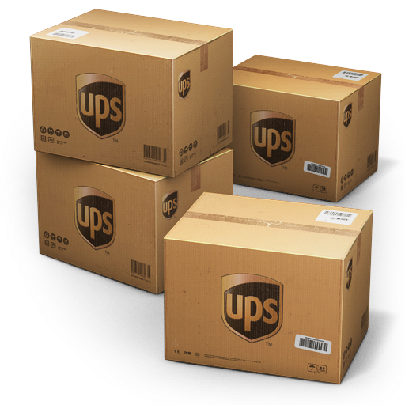
US EPA Region IV Funding
$25,000 supplemental grant funding – passed through FDACS
Created shipping account through UPS
Offset costs of specimen shipments to BADDL
Account becomes available in late Nov.
Create locations & usernames for each county
Process to sign in and print shipping labels

Slide 21
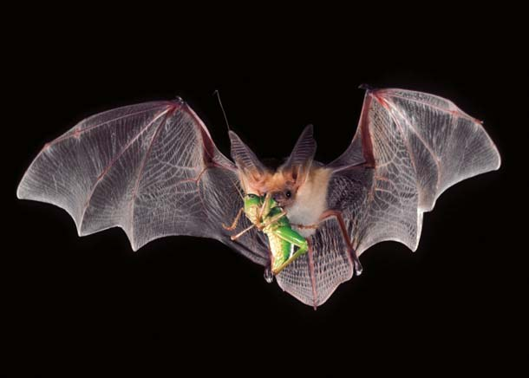
Hurdles
Resource constraints
Money, people, expertise (ID)
Awareness and public perception of pesticides
Naled, pyrethroids, even Bti
Accessing private property
Lack of specific location of cases
Increased cost to respond
Convincing citizens to take action
Reduce/eliminate breeding habitat on properties
Funding and spending constraints
Vehicles
Misconceptions
Role of the BG traps, bats and dragonflies as biological control agents
Government mistrust
Media – creating/intensifying controversy

Slide 22
Questions?
Adriane Rogers
ZikaMC@FreshFromFlorida.com
850-617-7929
Medical Entomologist
Entomology and Pest Control Section
Bureau of Scientific Evaluation and Technical Assistance
Division of Agricultural Environmental Services

